Slide 2
Who is A.S.A.?

Slide 3
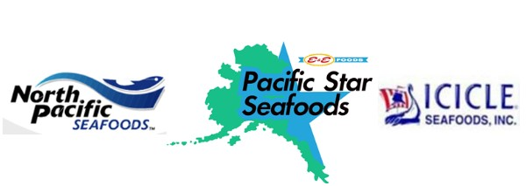
The Alaska Salmon Alliance (ASA) formed in 2011 as a 501 C (6), a nonprofit. Comprised of seafood processors and commercial fishermen our mission is to advocate for the salmon economy. The Alaska Salmon Alliance is an organization focused on public education, promoting the value of a healthy salmon resource and working to create predictable harvests for all salmon users in the Cook Inlet region.

Slide 4
Economic Engine

Slide 5
Data from: OceanEconomics.org

Slide 6
Data from: OceanEconomics.org

Slide 7
How was the 2019 UCI salmon season?

Slide 8
Data from: ADF&G

Slide 9
Escapement goals

Slide 10
2019 Kenai River
Sustainable Escapement Goal or S.E.G. was 700,000 – 1,200,000 fish In River Goal 1,000,000 – 1,300,000 fish
End of season escapement – 1,848,157 fish
Over escapement – 548,157 fish

Slide 11
2019 Escapement | 1,848,157 | Fish
Top end of in river goal | 1,300,000 | Fish
Difference | 548,157 | Fish over escaped
Total Number of fish | 548,157.00 | Fish over escaped
Average weight | 5.50 | lbs per fish
Total lbs. | 3,014,863.50 | Over escapement in lbs.
Fisherman
Total missed lbs. | 3,014,863.50
Average price paid | $2.00
Missed Fishermen Value | $6,029,727.00
Processor
Total Missed lbs. | 3,014,863.50
Finished H&G lbs | 2,261,147.63
Value Wholesale lbs. | $4.25
Total H&G Value | $9,609,877.41
Total Roe Value | $678,344.29
Missed Processor Value | $10,288,221.69
Local Economy
Fisherman + Processor | $16,317,948.69
Economic Multipler | 5
Kenai Peninsula Missed Value | $81,589,743.47

Slide 12
Thank you for your time.

