Slide 1
Ben Walters Lane Sidewalk Improvements Status
Leon Galbraith, P.E.
City Engineer
3/19/24

Slide 2
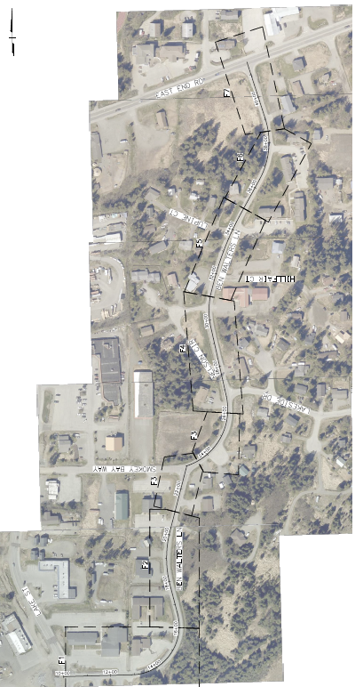
Project History
Ordinance 21-36(S-2)(A): 160 HART Roads Design/Survey
Ordinance 23-23(A-3): 160 HART Roads Construction
- Request for Proposals – Consultant Design Services – HDL selected to complete design
Project Finances
- Ben Walters Sidewalk - $100,000 for design/survey services (under budget so far), $1,700,000 for construction 2024
PRV Design/Construction added – Ordinance 23-64 estimated cost $300,000 funded from Water CARMA
Current Professional Design Services Status
Managing 3 consultant contracts: HDL, RESPEC, and Kinney Engineering
- Ben Walters Lane Sidewalk Improvements (100%) - HDL, Project No. 160-0798-XXXX
Ben Walters PRV Station (95%) – RESPEC - $45,000 design contract, PW design task order #24-01
Ben Walters Lane TCE/TCP acquisition – Kinney Engineering - $4,000 PW design task order #23-06

Slide 3
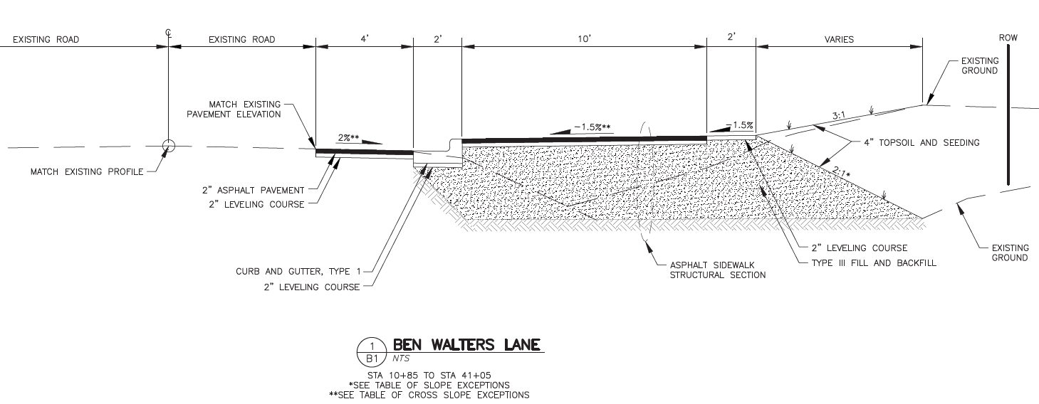
Ben Walters Lane Sidewalk Improvements
10’ wide asphalt sidewalk on east side
2” thick pavement & D-1 & subbase & geotextile
Curb and Gutter w/ SD inlets
ADA parallel curb ramps w/ tiles at approaches
Driveway curb cuts with ADA ramps
Utility adjustments (W/SS/SD/ELEC)
New street signs and posts
SD cross culverts to daylight drainage
Remove existing PRV and vault
New water main and fire hydrants
TOTAL CONSTRUCTION: $1,658,620

Slide 4
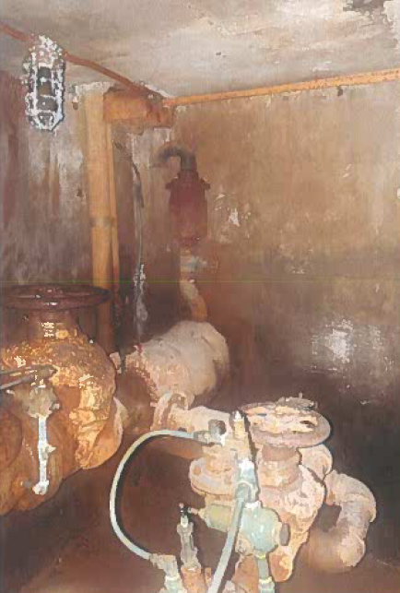
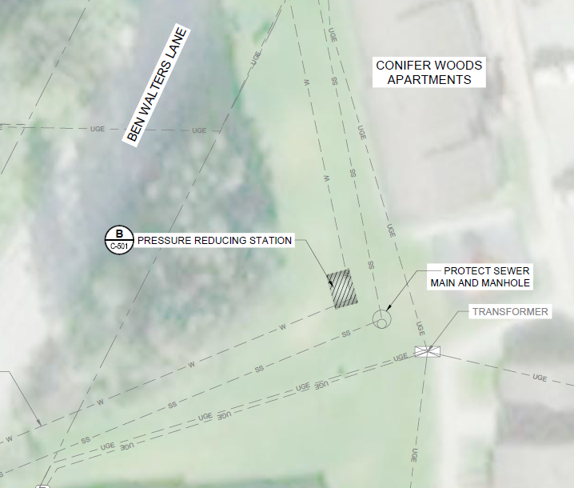
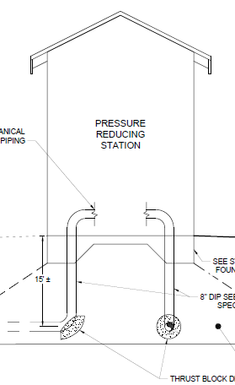
Ben Walters PRV Station
At 95% design level
- Need an EOQ and Eng. Cost Estimate
RESPEC currently addressing COH design review comments
ADEC coordination and review
Above grade shed within ex utility easement
Complex design includes architectural, civil, structural,
Mechanical and electrical elements and connections
- TOTAL CONSTRUCTION: $?

Slide 5
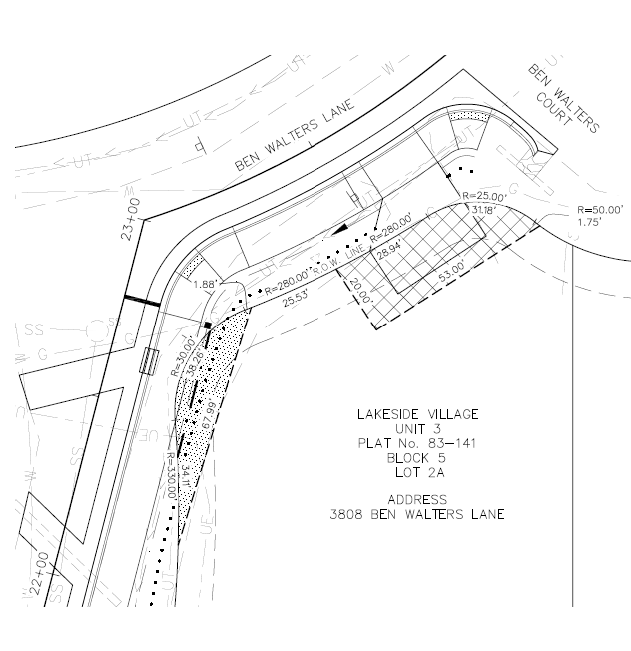
Ben Walters Lane TCE/TCP Acquisition
Outreach to property owners throughout corridor
In person contact and signature pages acknowledging private property impacts
No $$ for these easements/permits
15 individual ROW permits, 9 individual properties
Expected to wrap up task by end of April

Slide 6
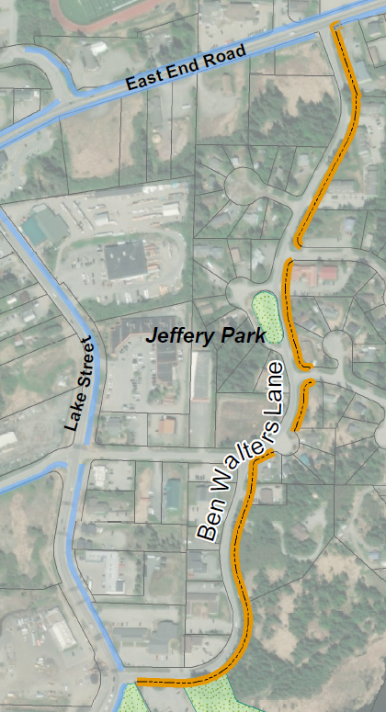
Next Steps
Provide final Plans/Specifications/Cost Estimate review comments to all 3 consultants
Coordination with and receive signed and sealed bid docs and permits from all
Receiving invoices and paying for our consultant professional services
Bidding/Advertising Package Prep
Project award and construction kickoff summer 2024
Project inspection and construction documentation and processing RFI / change orders
Project closeout
QUESTIONS?

