Slide 1



SHORT TERM RENTAL REGULATION
Economic Development Advisory Commission Work Session 1/9/24

Slide 2
AGENDA
10 MINUTES: STAFF PRESENTATION
10 MIN GENERAL Q&A
20 MIN BREAK OUT GROUPS 2 Q’S
30 MIN REPORT BACK AND DISCUSSION
10 MIN PUBLIC COMMENTS
10 MIN BREAK 5:50
6:00 REGULAR MEETING BEGINS

Slide 3
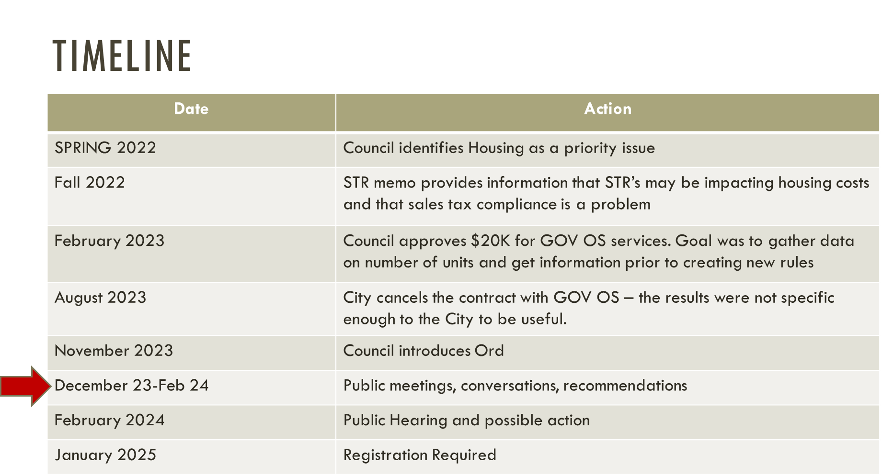

Slide 4

HOW TO COMMENT
City Website, comment form
Email: Planning@ci.homer.ak.us
Public Meetings

Slide 5
DEFINITION: STR
“Short-term rental” means a dwelling unit, or portion thereof, that is offered or provided to a guest for compensation for a period of less than 30 consecutive days. Short-term rentals may be in individual rooms in single-family homes, units in apartments, condominiums, townhouses, and multifamily dwellings.

Slide 6
01.
REQUIRES REGISTRATION
State Business license and KPB sales tax compliance form
02.
SELF CERTIFY BASIC LIFE SAFTEY
Smoke and CO2 detectors, fire extinguishers
03.
PROVIDE EMERGENCY CONTACT
For police department and neighbors within 300 feet
WHAT THE ORDINANCE DOES

Slide 7

WHAT IT DOES NOT DO
NO UNIT CAP
NO INSPECTION
CITY CAPACITY
There is no limit on the number of STR’s in a neighborhood or city wide
No life
Safety inspection required
No new staff, no increased enforcement

Slide 8
01.
WHAT IS A DWELLING?
Use zoning code definition?
02.
REGISTER FOR EACH UNIT (ROOM, CABIN) OR PER LOT?
Other permits are per lot
03.
CAPACITY LIMITS
Scrap bedroom occupancy limits?
04.
ONE YEAR VS TWO YEAR REGISRTATION?
Every two years would reduce burden on hosts and staff
LANGAUGE TO WORK THORUGH
05.
ENACTMENT DATE: JANAURY 2025
Free two year registration by end of 2024, fees start in 2025

Slide 9
THANK YOU
Have any question?
10 MIN GENERAL Q&A
20 MIN BREAK OUT GROUPS 2 Q’S
30 MIN REPORT BACK AND DISCUSSION
10 MIN PUBLIC COMMENTS
10 MIN BREAK 5:50
6:00 REGULAR MEETING BEGINS

Slide 10
01.
20 MINUTE BREAK OUT GROUPS (4:50)
1. FOR SHORT TERM RENTAL OWNER/OPERATORS: WHAT PROBLEMS DO YOU SEE WITH THE ORDINANCE? SUGGESTIONS?
2. FOR EVERYONE: WHAT OTHER COMMENTS OR CONCERNS DO YOU HAVE? SUGGESTIONS?
02.
30 MINUTE REPORT BACK + DISCUSSION (5:10)
03.
10 MIN PUBLIC COMMENT (5:40)
04.
10 MIN BREAK (5:50)

