Slide 1
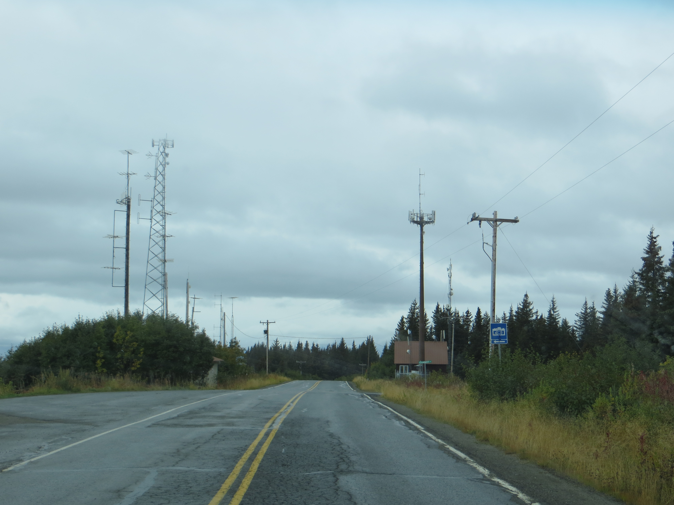
Tall Structures
Towers and Wind energy systems

Slide 2
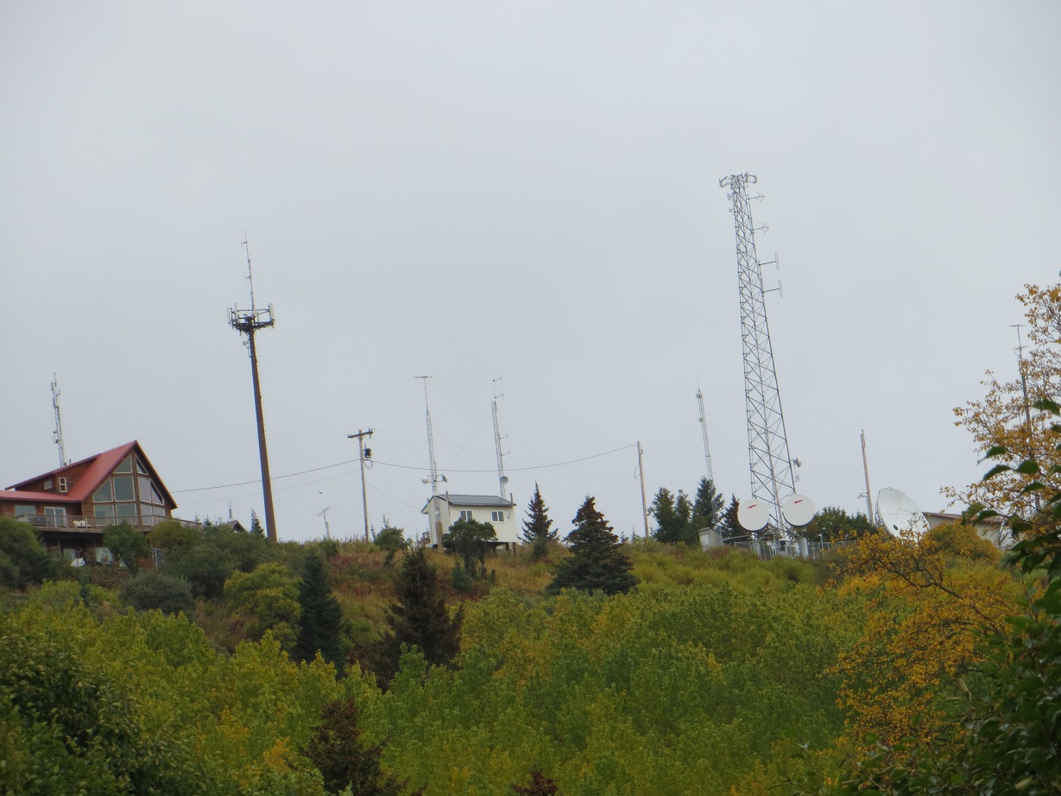
What we do now.
  CUP for large towers and sites solely dedicated to towers under the definition of “public utility facility of structure”, specifically “telecommunications tower or structure”
  Many facilities mounted on structures and/or accessory to another use may not have permits.

Slide 3
Current issues with permitting
  No definition for “telecommunications tower or structure”
  No expectations for site design exists for Planning Commission review
  While I have few complaints about new towers in industrial or commercial areas of town, many protest residential proposals

Slide 4
The general concept of the proposed ordinance
District Maximum Height (feet)
CBD 60
TC 60
GBD 60
GC1 120
RO 85
UR 60
RR 85
CONS 60
GC2 120
EMU 120
MI 120
MC 120
OSR 60
BCWPD 120
a. Define tower and associated structures and activities
b. Carve out where towers are encouraged and not so encouraged
i. Make permitting predictable where encouraged
1. Commercial and industrial districts
2. Under specified heights, Table HCC 21.58.030

Slide 5
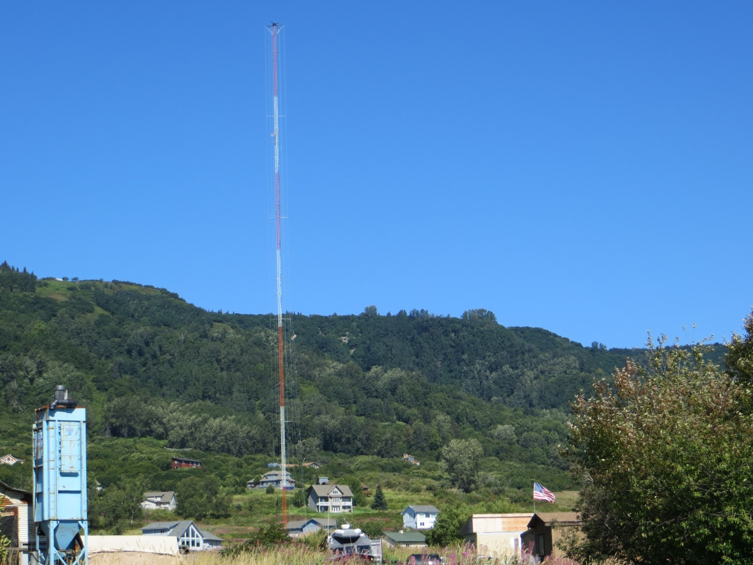
General ordinance concepts
1. Create comprehensive public process in less ideal locations such as
-Residential districts
-Over specified heights
2. Excluded from new ordinance
-Tower less than 35ft.
-Amateur radio
-When in compliance with federal guidelines
-Towers extending less than 10ft. from rooftop or 35 ft. total height
275 ft. “guyed” tower Kachemak City

Slide 6
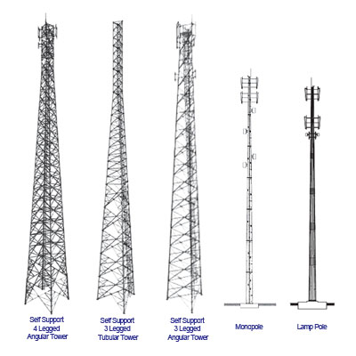
Items we wish to consider when permitting
  Necessity for a new tower
    -Why can it not be collocated?**
    -What other locations have been investigated
    -Appropriate radius for consideration of alternates **
  Demonstrate that it is not excessive **
  Analyze visual impact and minimize **
  Certify safety

Slide 7
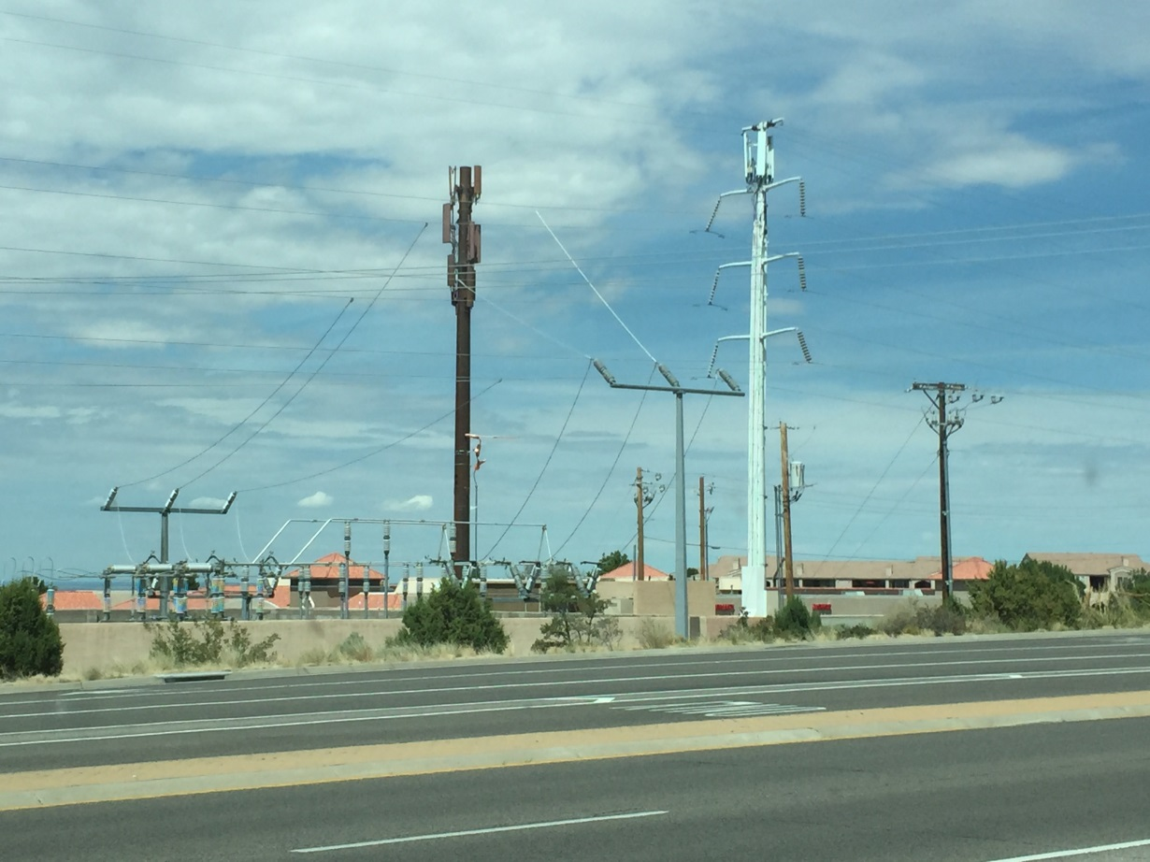
Standards
  -1.1 times total height setback from property line supporting dwellings or public assembly***
  -Provide colocation opportunities
  -Blend in with environment

Slide 8
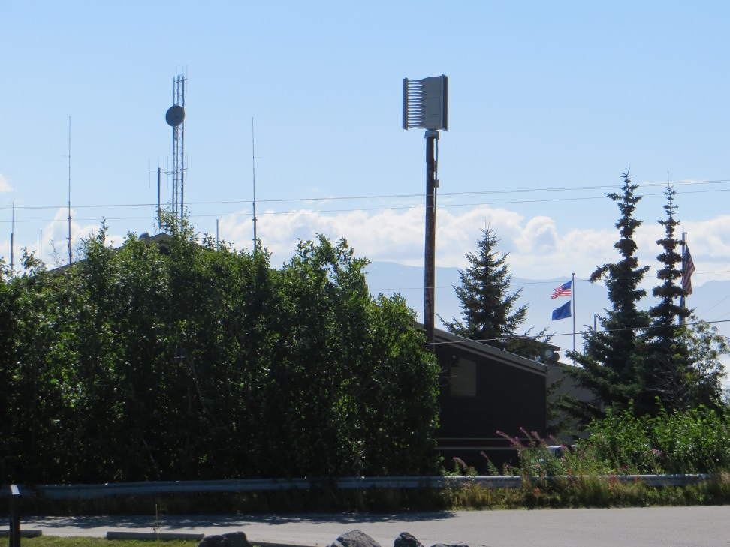
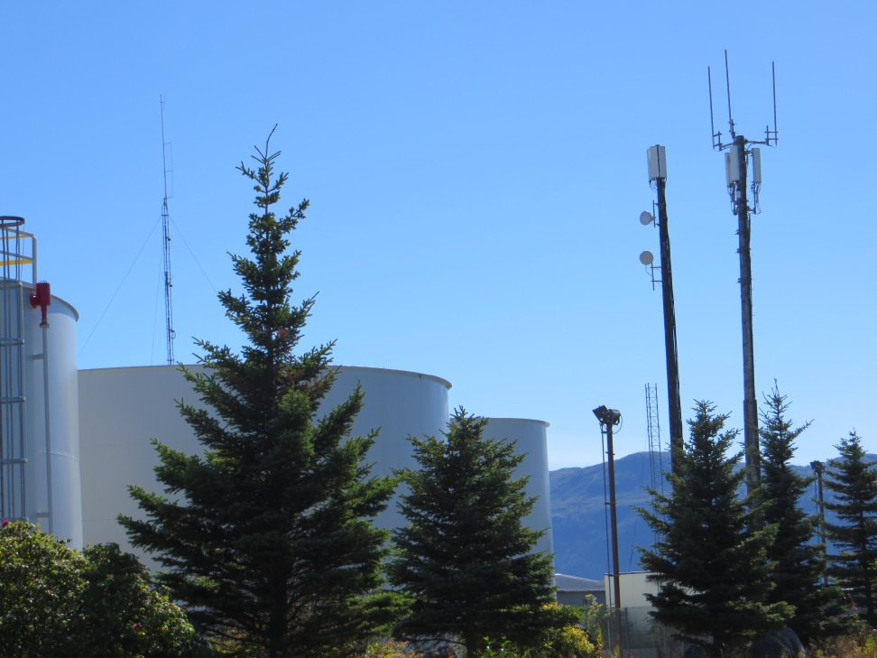
These things are all over town
Police station 26 ft.
Near tank farm 65 – 75 ft.

Slide 9
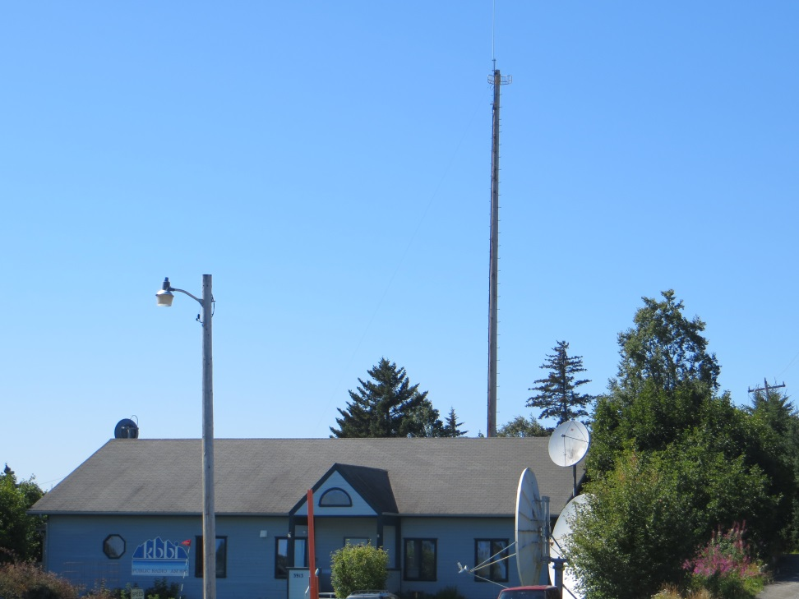
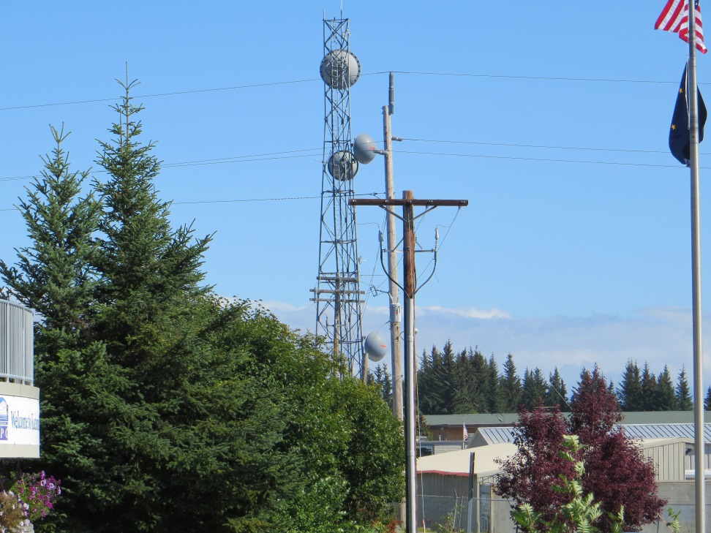
These things are all over town
KBBI 83ft.
HEA 100 ft.

Slide 10
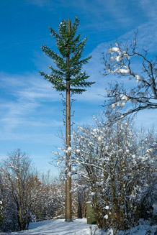
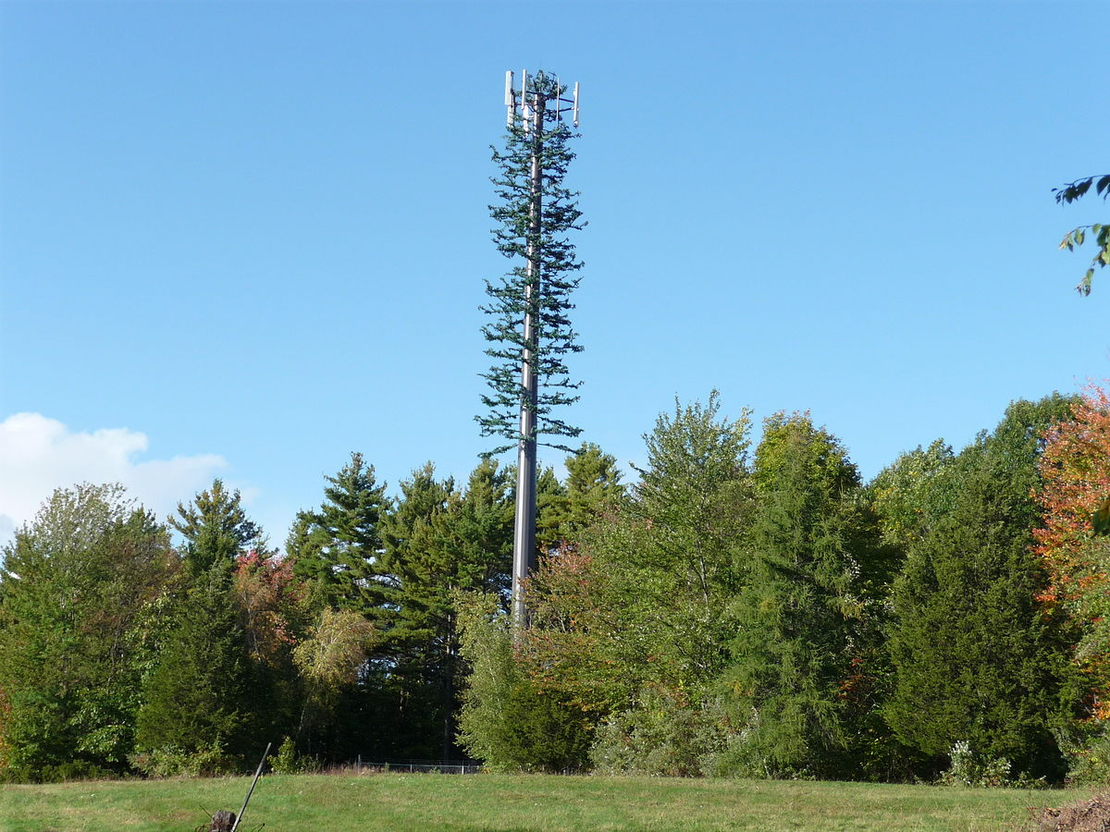
Shall we disguise
Mono pine
Mono pine

Slide 11
What kind of ordinance shall we forward
Several items in the presentation were marked with asterisks
  These are items may need expertise above that of the Planning Office
    Colocation conditions and other sites considered
    Consideration for when a tower or towers are excessive
    Visual impact and application of alternatives

Slide 12
Options: Third party technical assistance
Advantages include
  Ordinance crafting
  Industry experts
  Timely review
  No cost to city
  Will defend legal challenges
  Leaves planners to work on other tasks
Disadvantages include
  cost to applicants, all costs are to be provided in security by an applicant with application
  Reviews may be completed from afar (although may be negated by technology)
Council input requested

Slide 13
Setback Standards
The distance from a communications tower to the closest property line of a lot that contains a dwelling unit, dormitory, hotel, motel, bar, restaurant, school, day care facility, church, retail establishment or place of public assembly may not be less than 1.1 times its total height.

Slide 14
Setback concerns of 1.1
issues
options
Adequate degree of safety
Few if any current towers meet the standard
Greatly restricts where a tower may be located
  Not a lot of large lots in some parts of town
  Tower would be located in center of lots and may restrict other opportunities
Reduce setback to 50%
Exceptions in commercial districts
Reduce setback to that of actual structures not property line
  Negatives include
    Encroachment on undeveloped land
    reduced safety
Council input requested

Slide 15
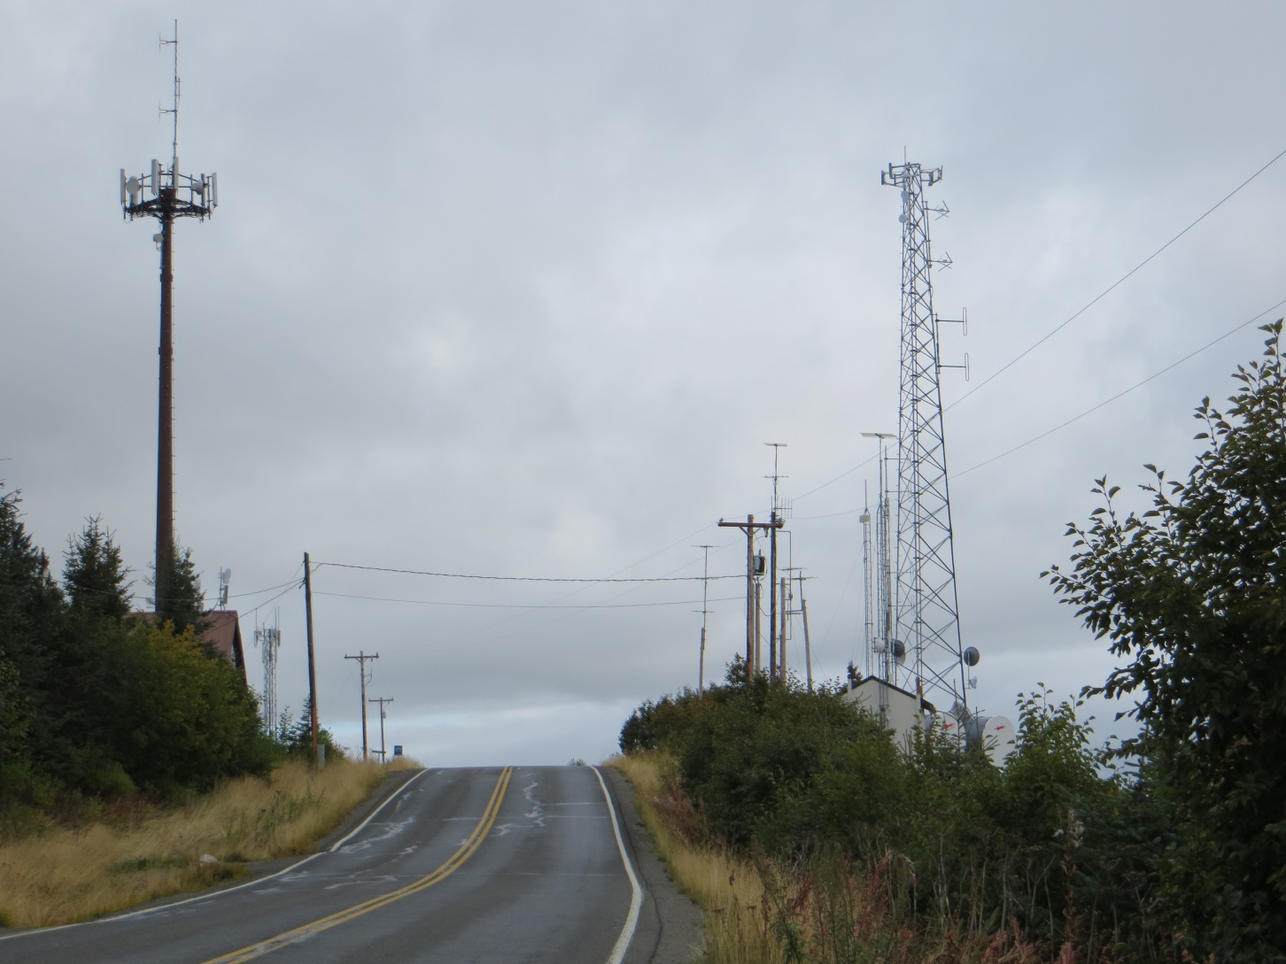
Please provide feedback so that it may be responded to prior to City Council hearing

