Slide 1
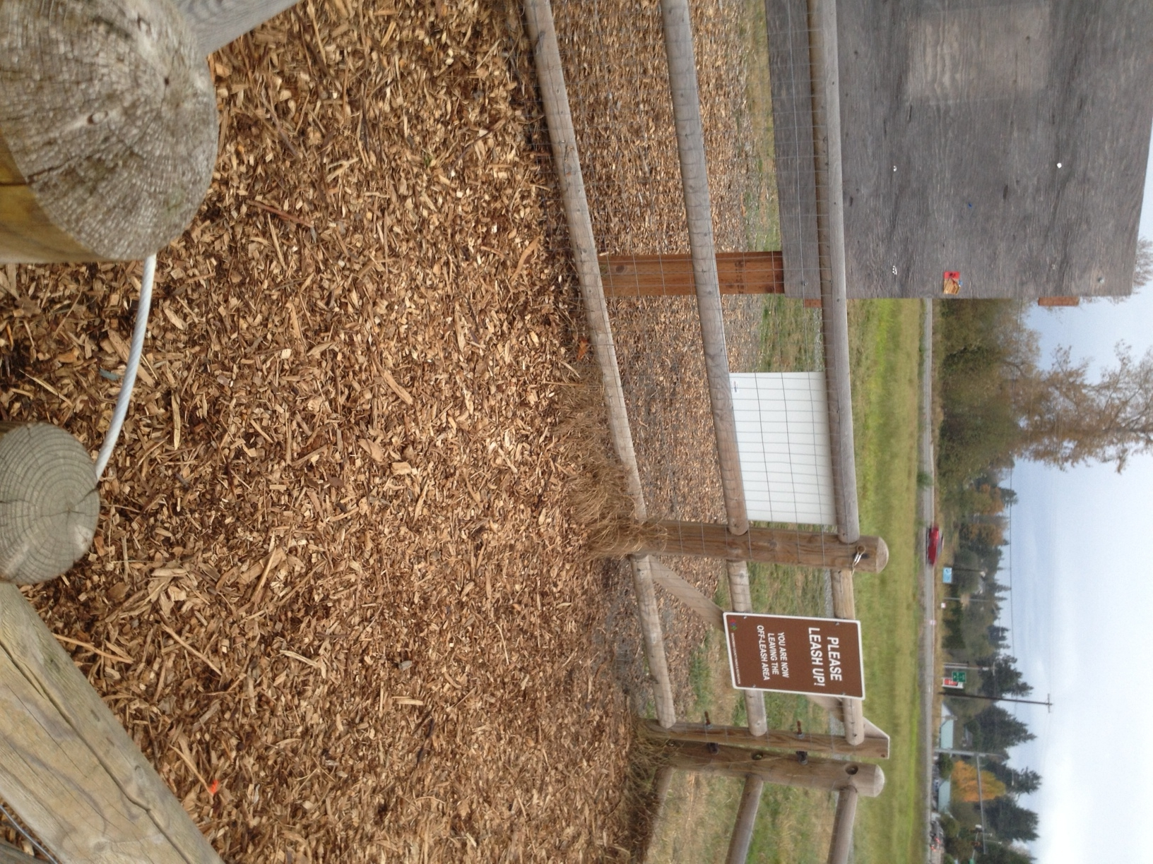
Notes:
DOG YARD LEASHING UP AREA – SAFE ENCLOSURE SO DOGS DO NOT RUN AWAY

Slide 2
SAFE ENCLOSURE – DOGS SECURE

Slide 3
VIEW FROM DOG YARD OF ENCLOSURE FOR UNLEASHING

Slide 4
DOGGIE PLAY AREA
Notes:
HEALTHY DOGS ENJOY EXER

Slide 5
MORE DOGGIE PLAY- HIDE AND SEEK IS FUN!

Slide 6
THIS IS A REALLY SAFE FENCE DESIGN!

Slide 7
PICK UP AFTER YOUR DOG ! POOOPIE HOLDERS PROVIDED

Slide 8
RULES ARE IMPORTANT- OWNERS WITH DOGS, NO DOGS WITHOUT

Slide 9
SIGNAGE FOR SAFE UNLEASHING OF YOUR PET

Slide 10
HOMER CAN HAVE THIS

Slide 11
BUILDING A SAFE DOG PARK IN HOMER ALASKA

