Slide 1
City of Homer Municipal Art
Collection
Section 1 - Artwork located at the Homer Airport.
Photographs and Information Prepared and Presented by
Jim Lavrakas
Far North Photography
In Collaboration with the City of Homer
Parks, Art, Recreation & Culture Advisory Commission

Slide 2
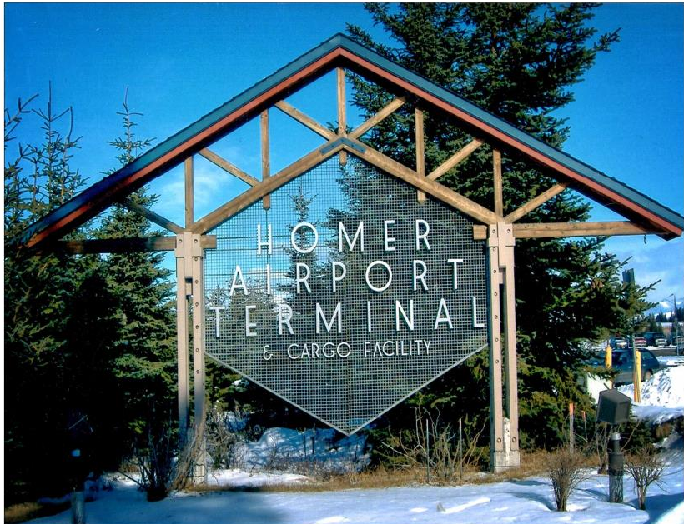

Slide 3
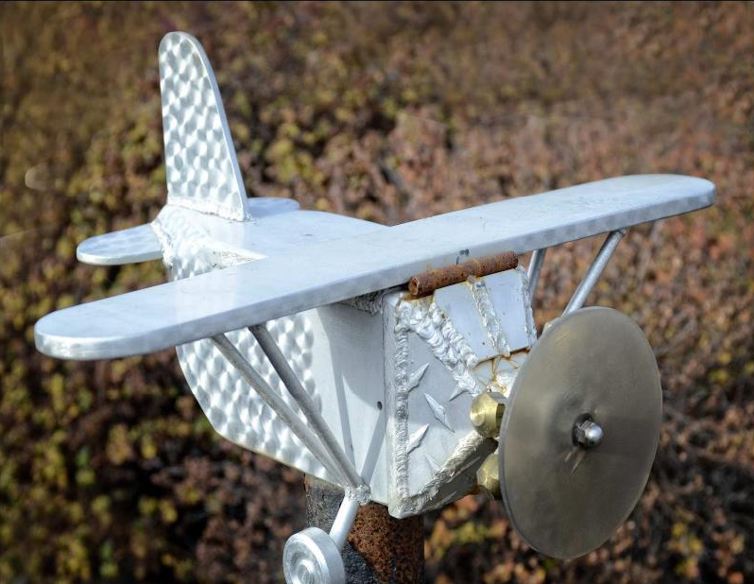

Slide 4
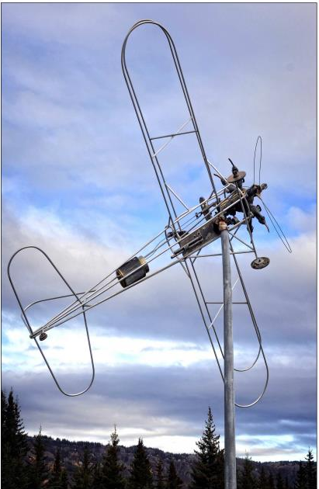

Slide 5
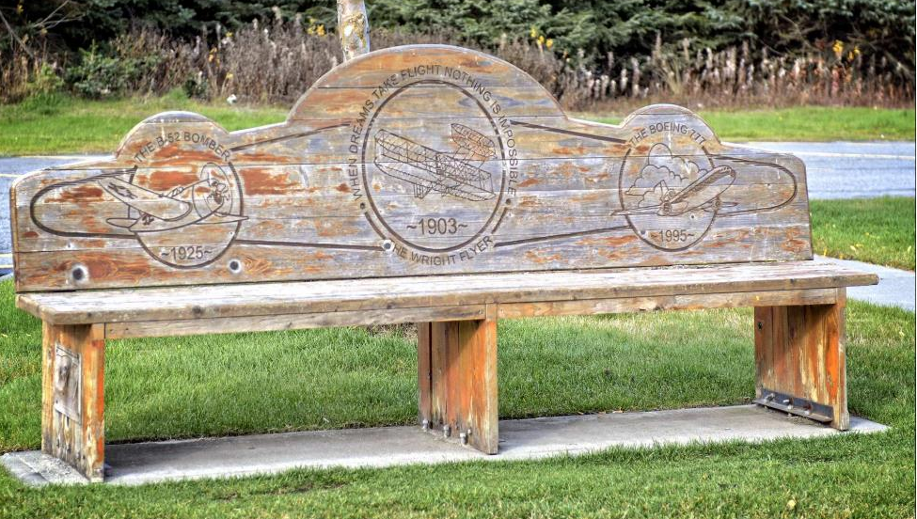

Slide 6
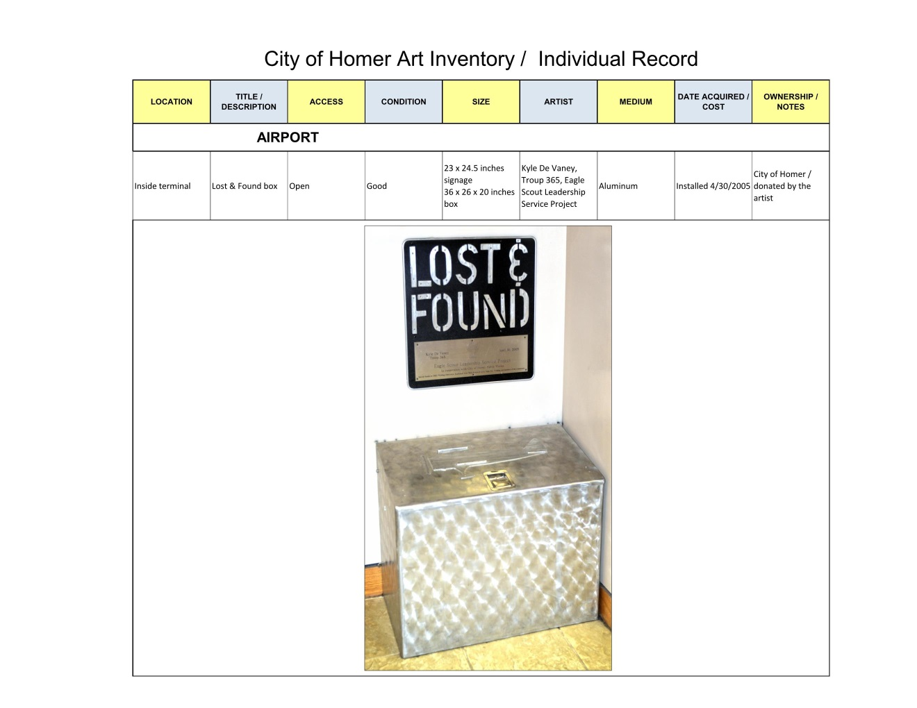

Slide 7
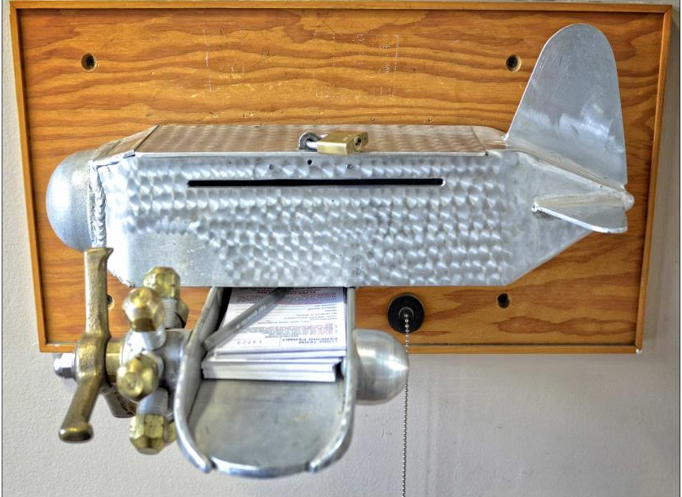

Slide 8
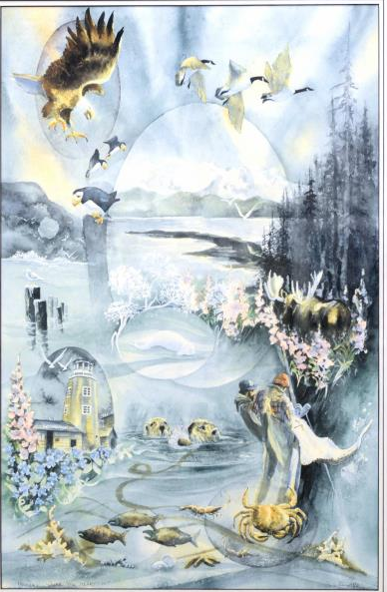

Slide 9
