Slide 1
City of Homer Municipal Art Inventory
This section contains artwork located at the Animal Shelter.
The Shelter is located next to the Public Works facility on the Sterling Highway
Photos and Information Prepared and Presented by
Jim Lavrakas
Far North Photography
In Collaboration with the City of Homer
Parks, Art, Recreation & Culture
Advisory Commission

Slide 2
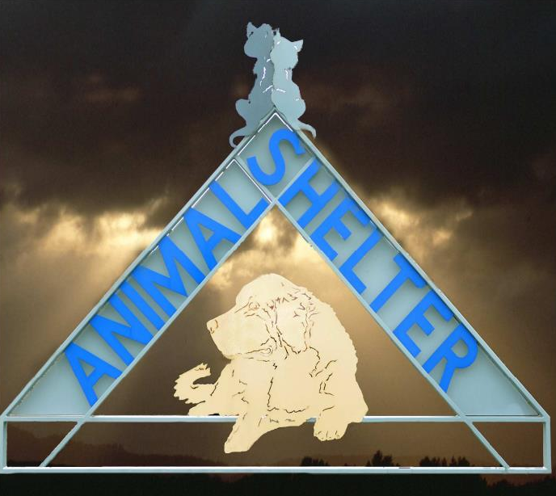

Slide 3
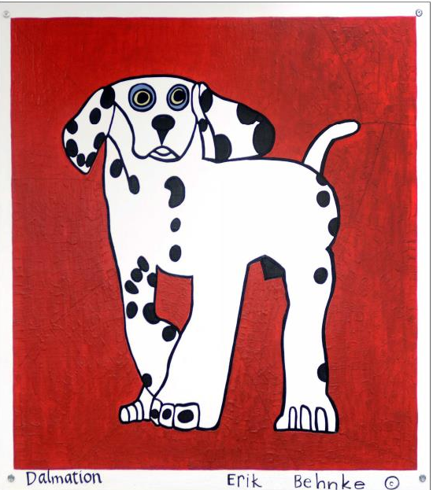

Slide 4
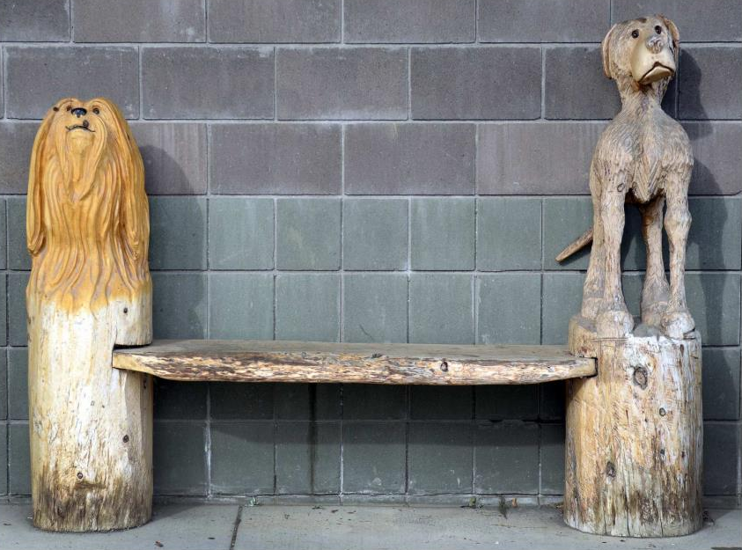

Slide 5
