Slide 1
City of Homer Municipal Art Inventory
Section 4 – Artwork located at City Hall - Sister City Collection from Teshio, Japan with a few pieces from Auckland, New Zealand and Lampang, Thailand
This collection has been divided into smaller sections for ease in viewing
Photos and Information Prepared and Presented by
Jim Lavrakas
Far North Photography
In Collaboration with the City of Homer
Parks, Art, Recreation & Culture Advisory Commission

Slide 2
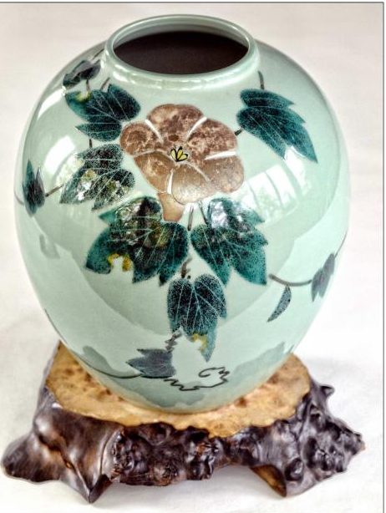

Slide 3
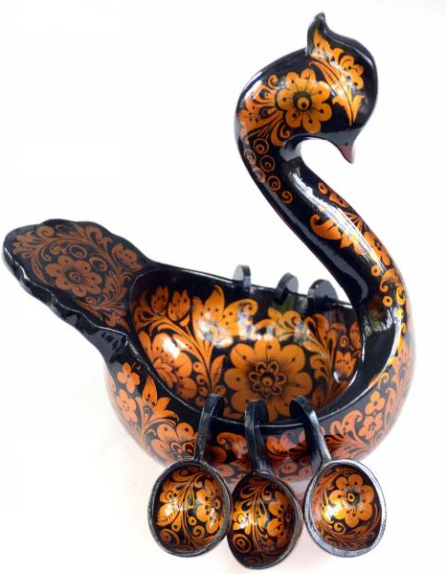

Slide 4
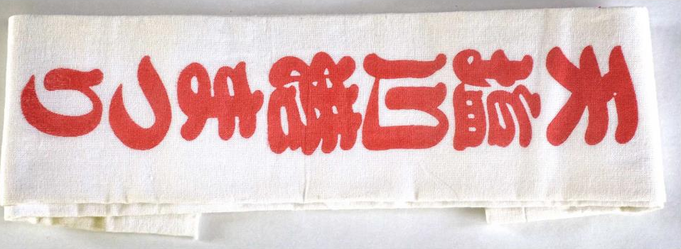
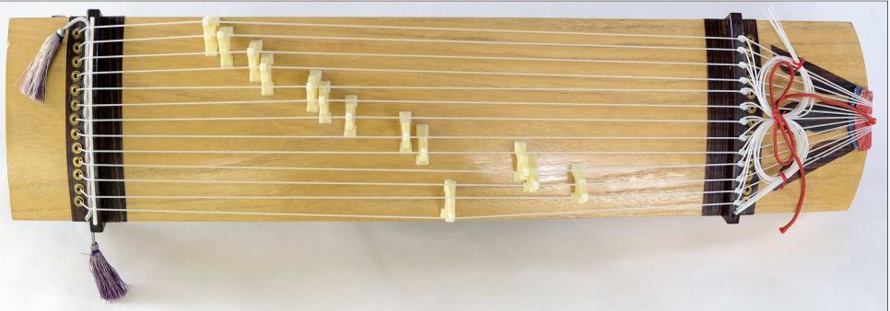

Slide 5
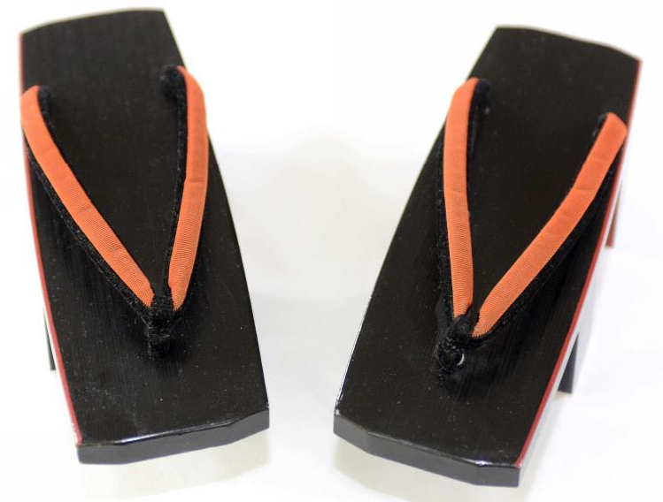

Slide 6
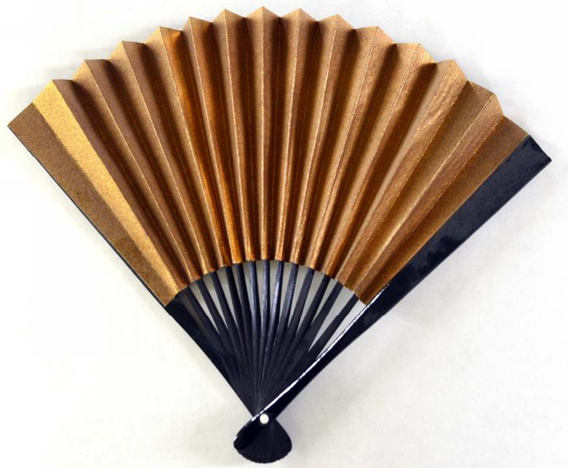
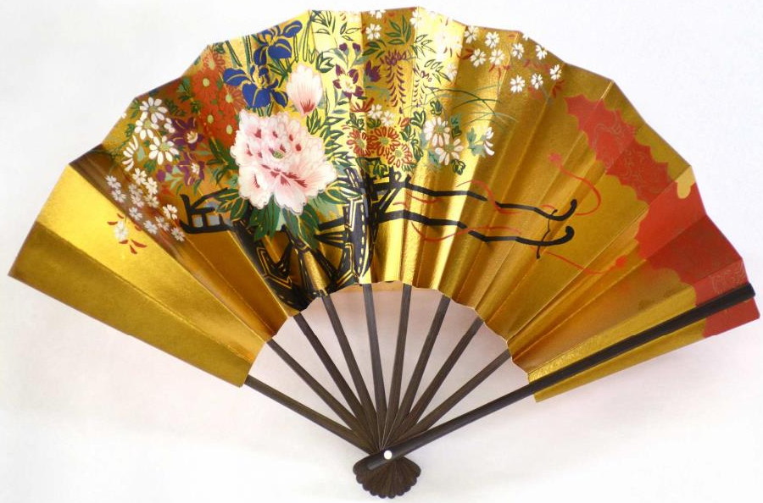

Slide 7
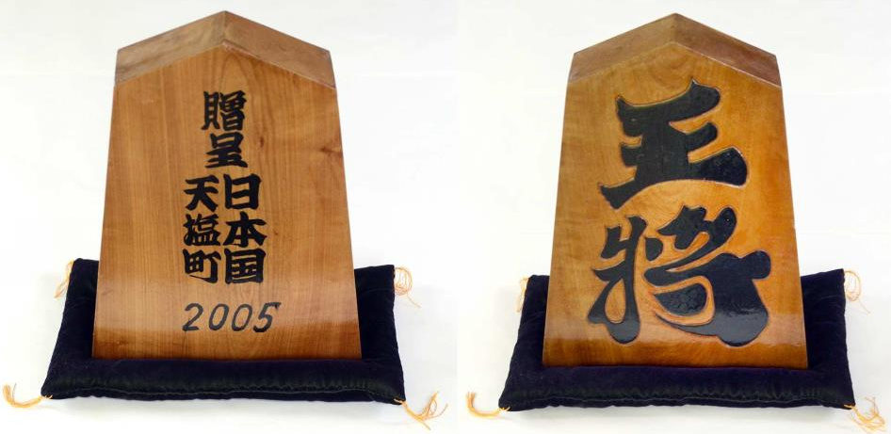
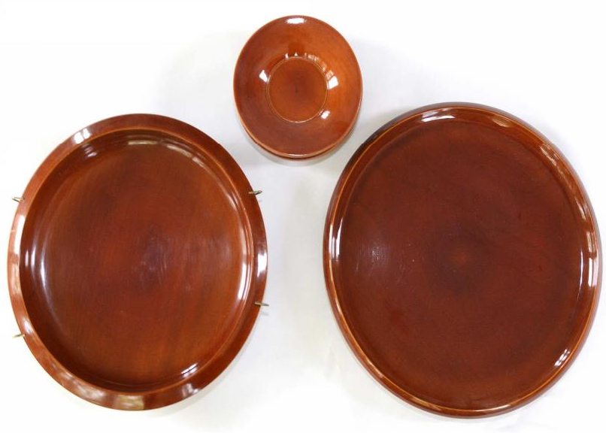

Slide 8
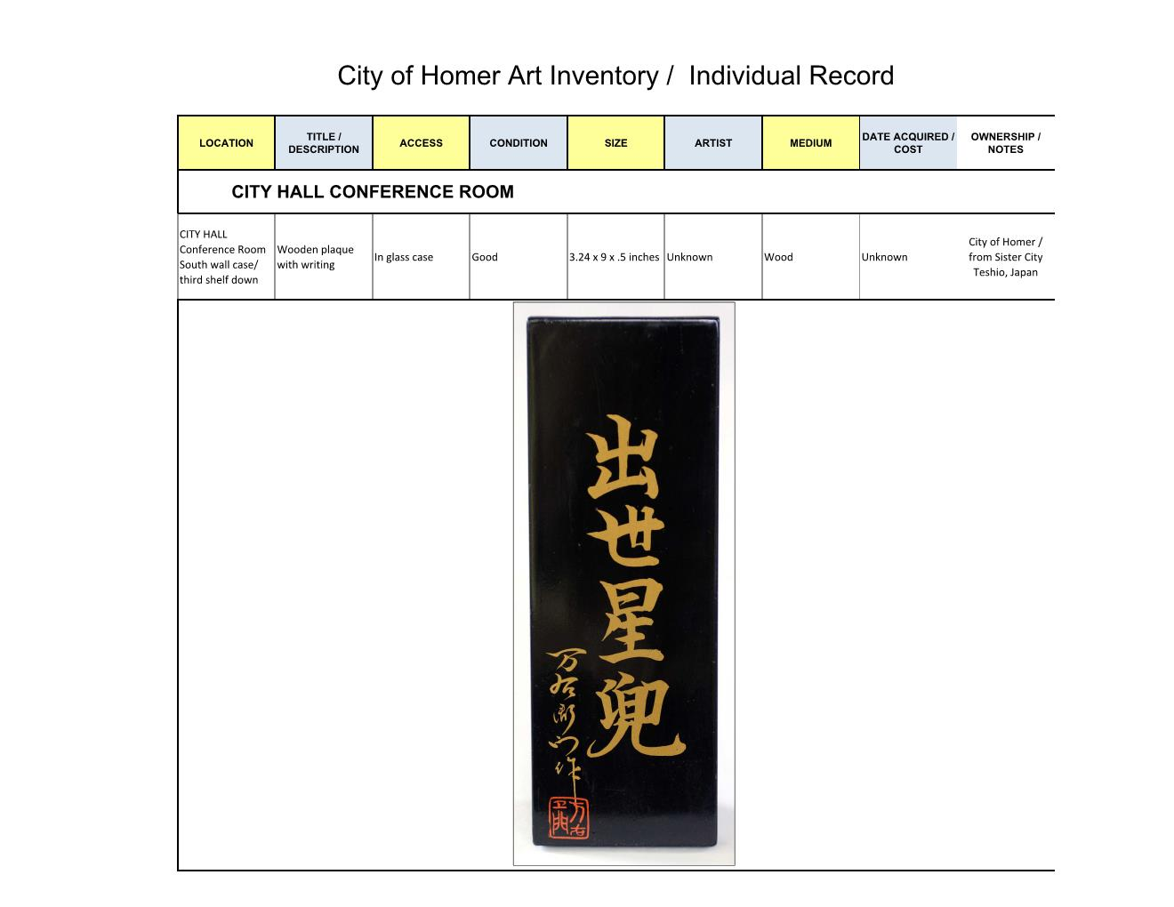
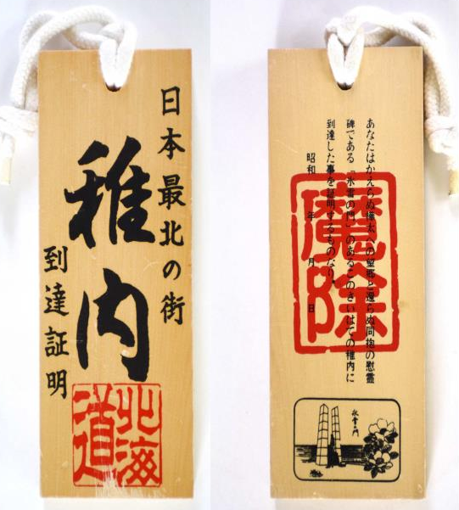

Slide 9
