Slide 1
City of Homer Municipal Art Inventory
Section 4 – Artwork located at City Hall - Sister City Collection from Teshio, Japan with a few pieces from Auckland, New Zealand and Lampang, Thailand
This collection has been divided into smaller sections to ease in viewing.
Photos and Information Prepared and Presented by
Jim Lavrakas
Far North Photography
In Collaboration with the City of Homer
Parks, Art, Recreation & Culture Advisory Commission

Slide 8
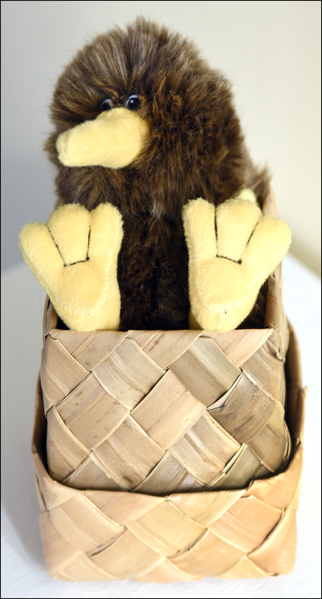
LOCATION | TITLE / DESCRIPTION | ACCESS | CONDITION | SIZE | ARTIST | MEDIUM | DATE ACQUIRED / COST | OWNERSHIP / NOTES
CITY HALL CONFERENCE ROOM
City Hall Conference Room South wall case/ bottom shelf | Tea cup with top and base | In glass case | Excellent | 5.5 X 4 inches | Unknown | Ceramic | Unknown | City of Homer / from Lampang City, Thailand
LOCATION | TITLE / DESCRIPTION | ACCESS | CONDITION | SIZE | ARTIST | MEDIUM | DATE ACQUIRED / COST | OWNERSHIP / NOTES
CITY HALL CONFERENCE ROOM
South wall case/ bottom shelf | Kiwi doll in woven box | In glass case | Excellent | 4x5x4 inches | Manufactured | Cloth / grass | Unknown | City of Homer / from Aukland, New Zealand

