Slide 1
City of Homer Municipal Art Inventory
Section 5 – Artwork located at Homer Volunteer Fire Station
and Homer Police Department
Photos and Information Prepared and Presented by
Jim Lavrakas
Far North Photography
In Collaboration with the City of Homer
Parks, Art, Recreation & Culture Advisory Commission

Slide 2
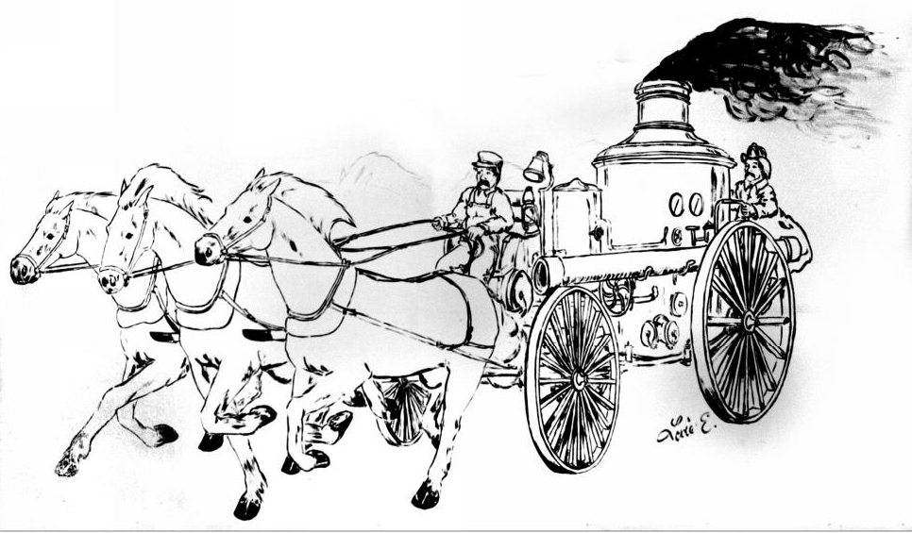

Slide 3
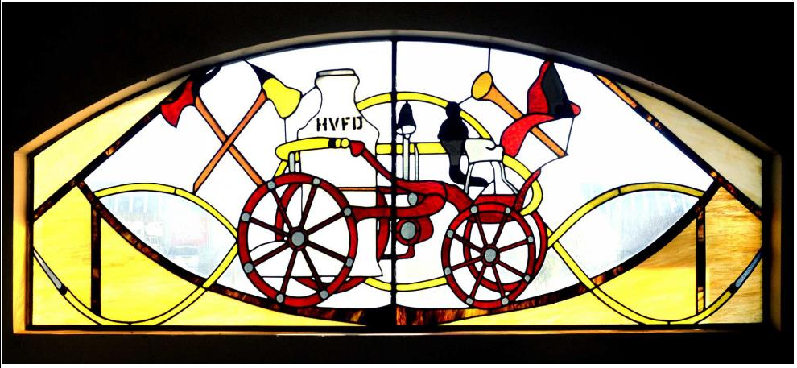
LOCATION | TITLE / DESCRIPTION | ACCESS | CONDITION | SIZE | ARTIST | MEDIUM | DATE ACQUIRED / COST | OWNERSHIP / NOTES
HOMER VOLUNTEER FIRE DEPARTMENT
Public entrance lobby | Stain glass window above door | Open | Excellent | 75 x 26 inches | Vic Hiles | Stain glass | 1979 | City of Homer

Slide 4
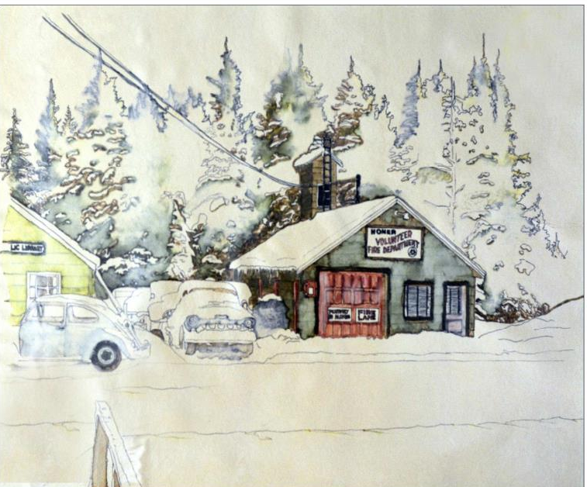

Slide 5
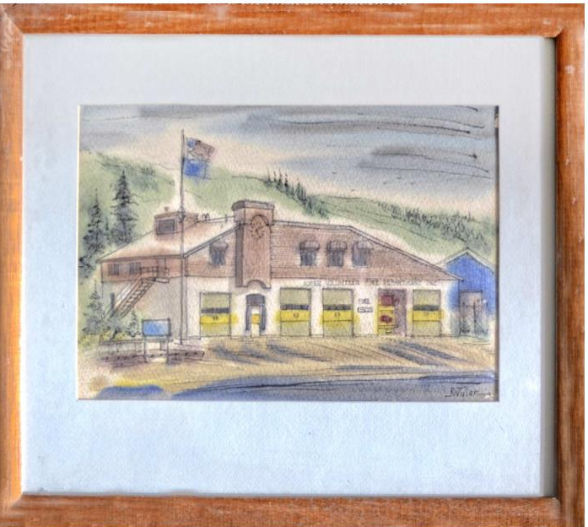

Slide 6
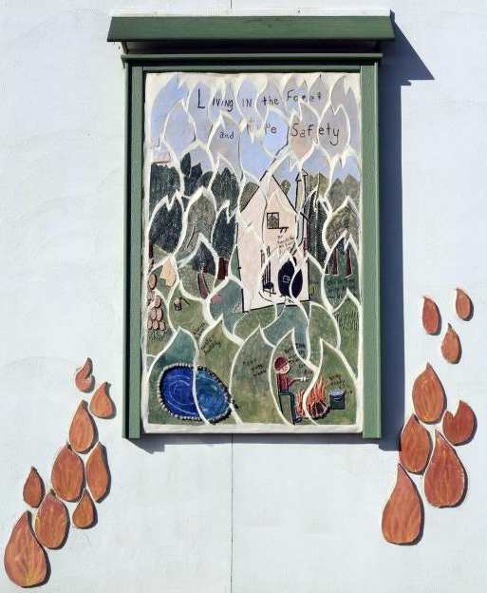

Slide 7
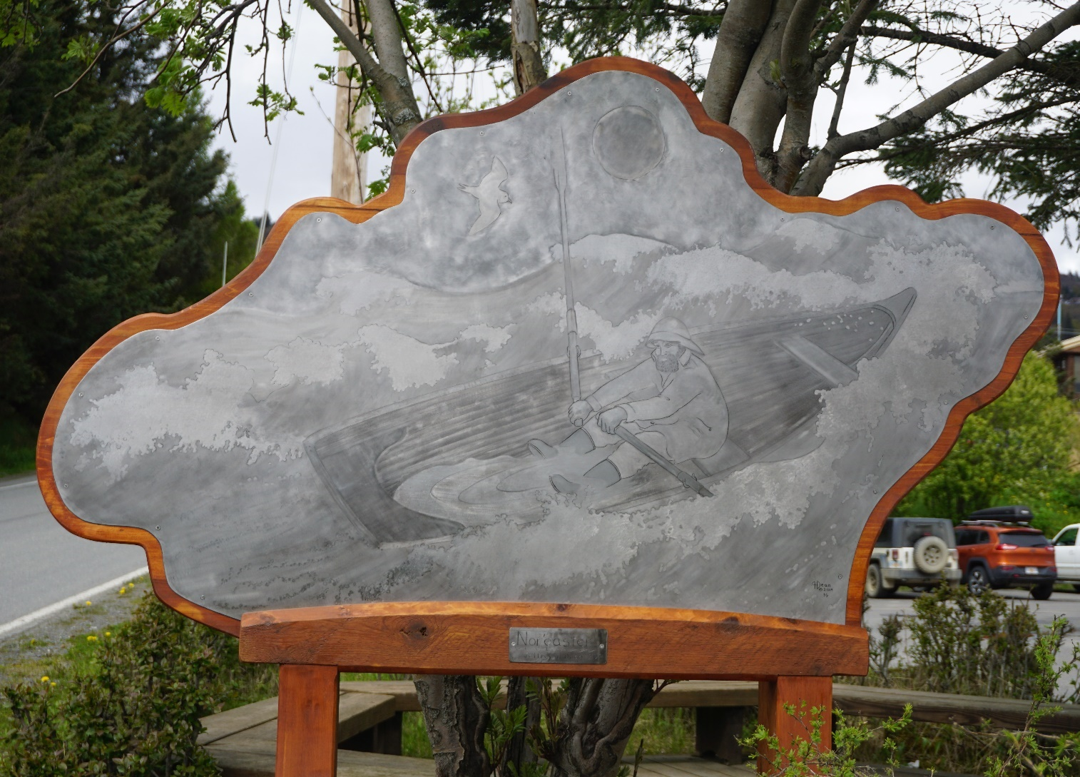
LOCATION | TITLE / DESCRIPTION | ACCESS | CONDITION | SIZE | ARTIST | MEDIUM | DATE ACQUIRED / COST | OWNERSHIP / NOTES
PUBLIC WORKS / PARKS
Fire Department/Pocket Park Heath Street & Pioneer Avenue | "Nor'easter" | Open | Excellent | 80” high x 72” wide x 1.75” deep. | Jeffrey H. Dean, Creative Fires Studio | Brass & Cedar | 2019 | City of Homer 1% for Art Program - 2017-2018 Fire Department Renovation Project

Slide 8
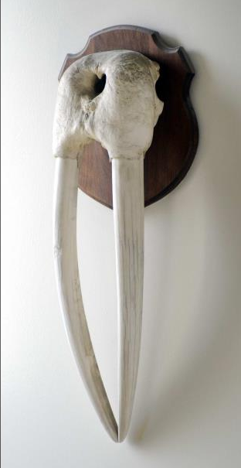
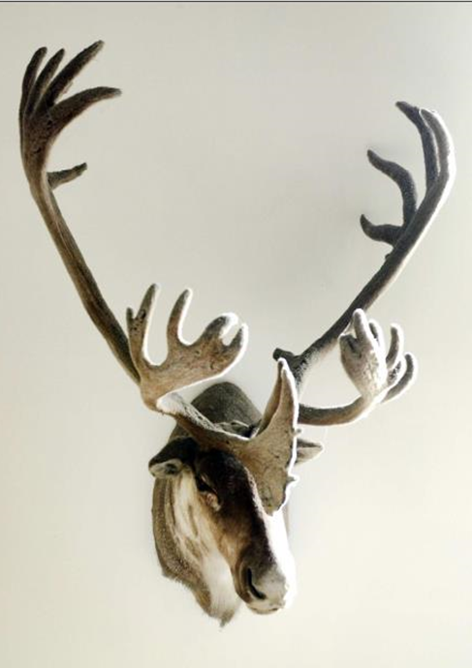
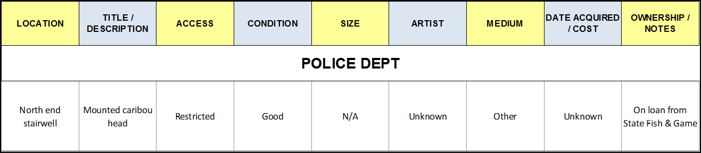

Slide 9
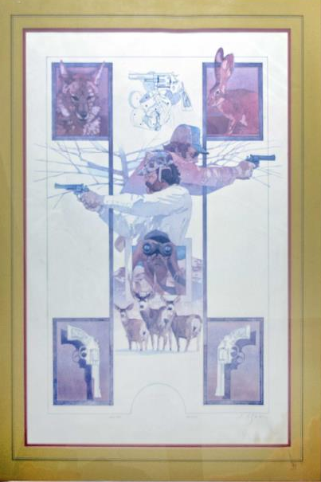

Slide 10
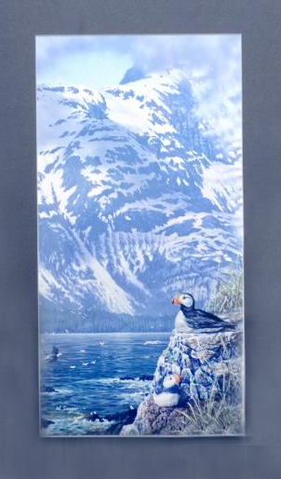

Slide 11
