Slide 1
City of Homer Municipal Art Inventory
Section 6– Artwork located at the Harbormaster’s Office
Photos and Information Prepared and Presented by
Jim Lavrakas
Far North Photography
In Collaboration with the City of Homer
Parks, Art, Recreation & Culture Advisory Commission

Slide 2
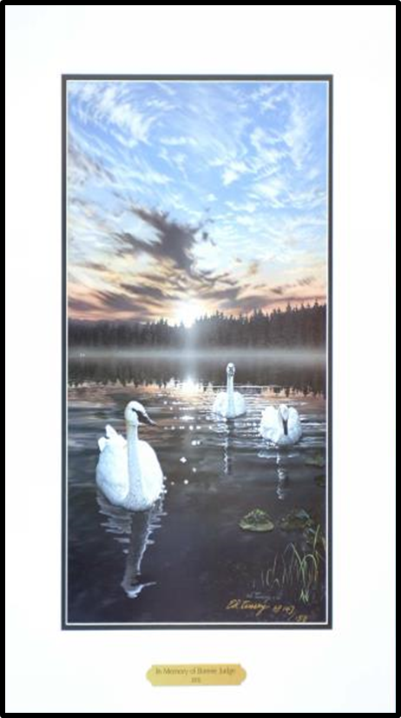
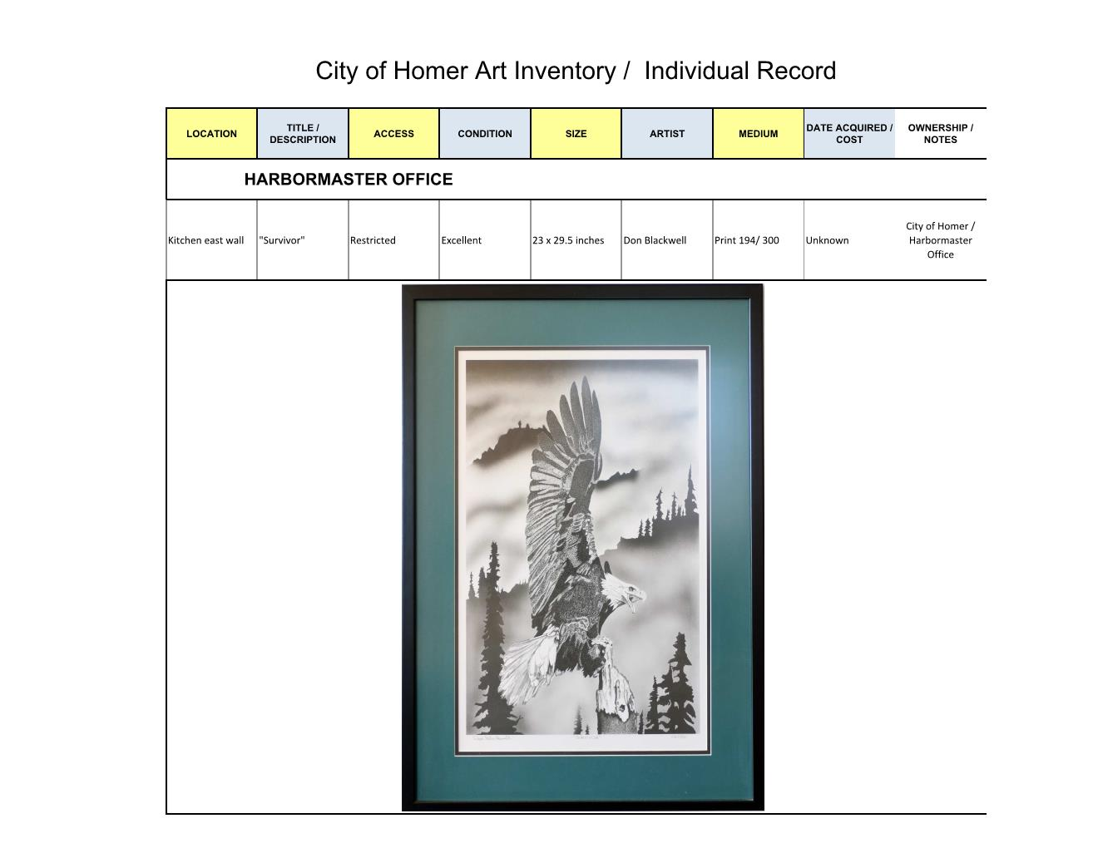

Slide 3
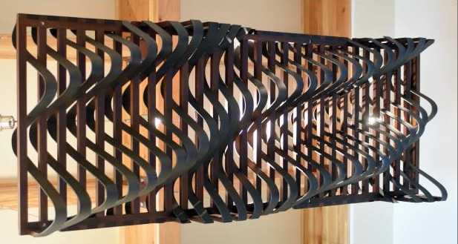

Slide 4
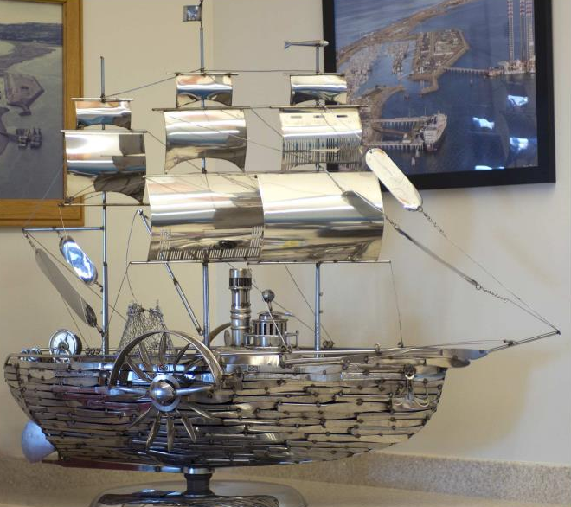

Slide 5
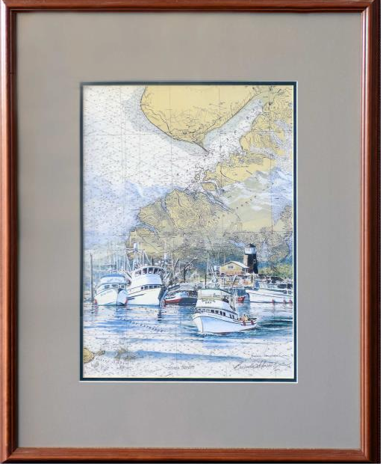

Slide 6
