Slide 1

City of Homer Municipal Art Inventory
This section consists of artwork located within City Hall
Photos and Information Prepared and Presented by
Jim Lavrakas
Far North Photography
In Collaboration with the City of Homer
Parks, Art, Recreation & Culture
Advisory Commission

Slide 2
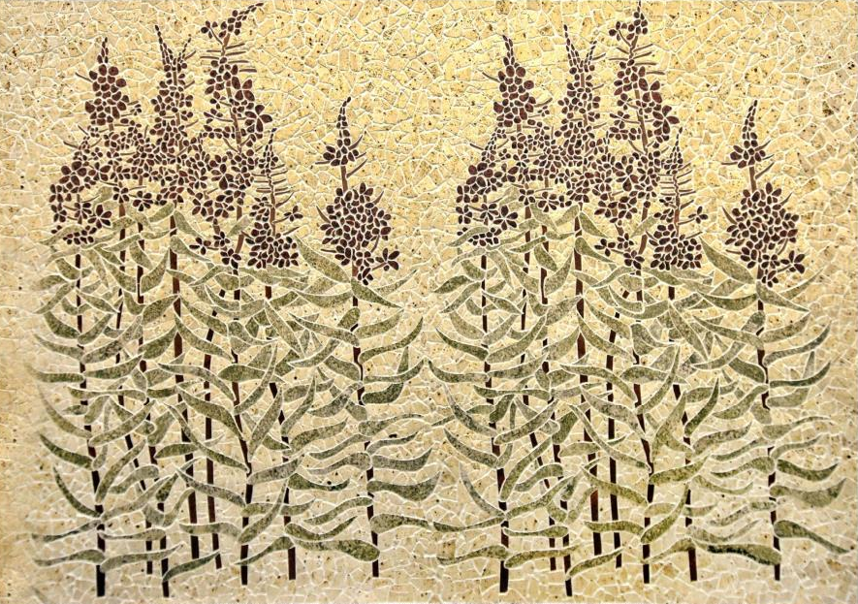

Slide 3
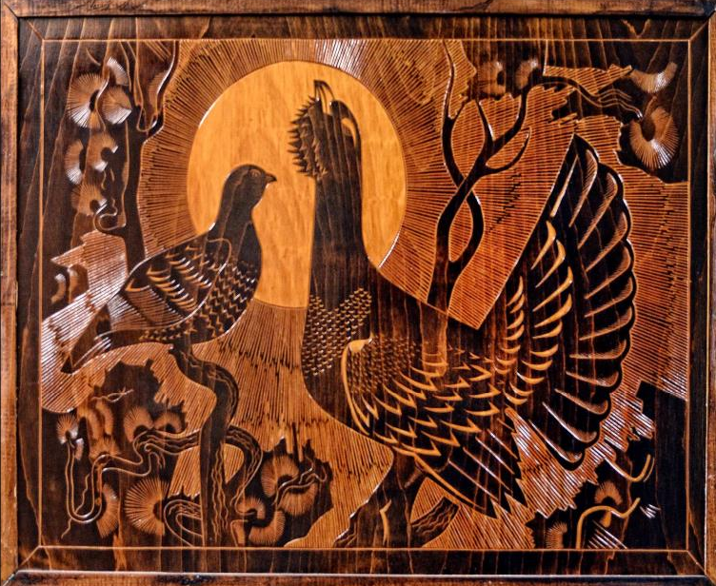

Slide 4
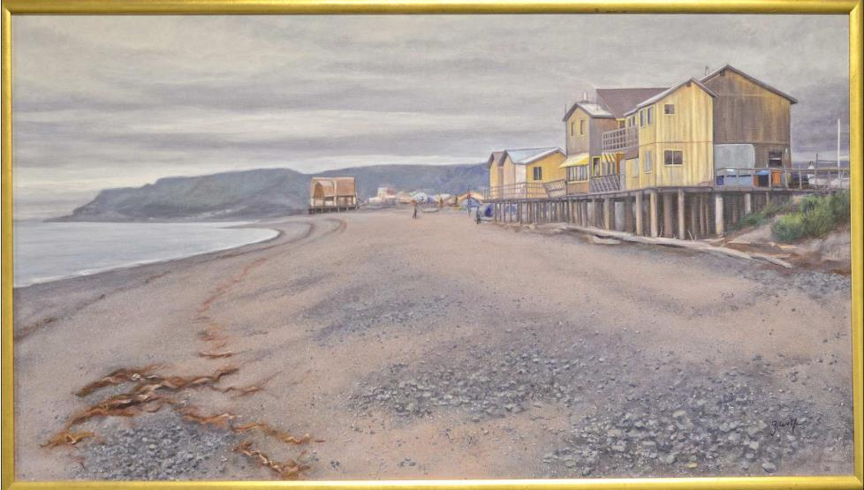

Slide 5
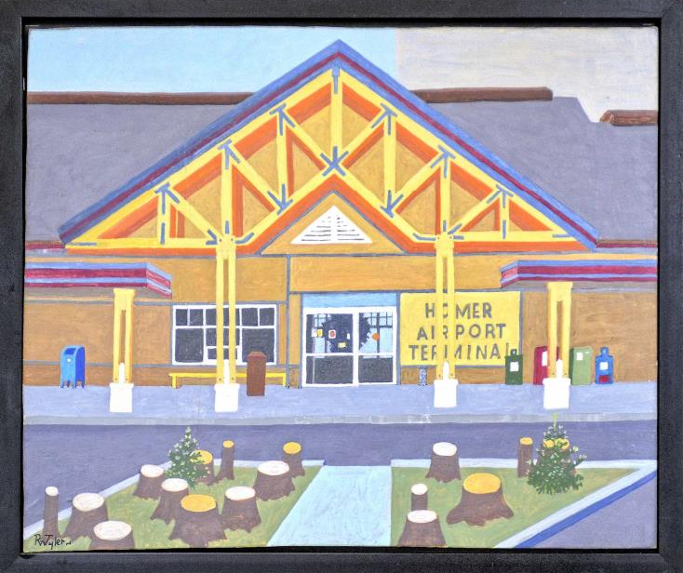

Slide 6
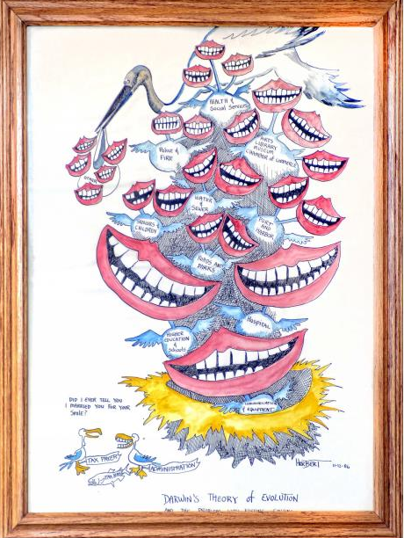

Slide 7
