Slide 1
City of Homer Municipal Art Inventory
Section 9 Artwork located in City Parks
Photos and Information Prepared and Presented by
Jim Lavrakas
Far North Photography
In Collaboration with the City of Homer
Parks, Art, Recreation & Culture
Advisory Commission

Slide 2
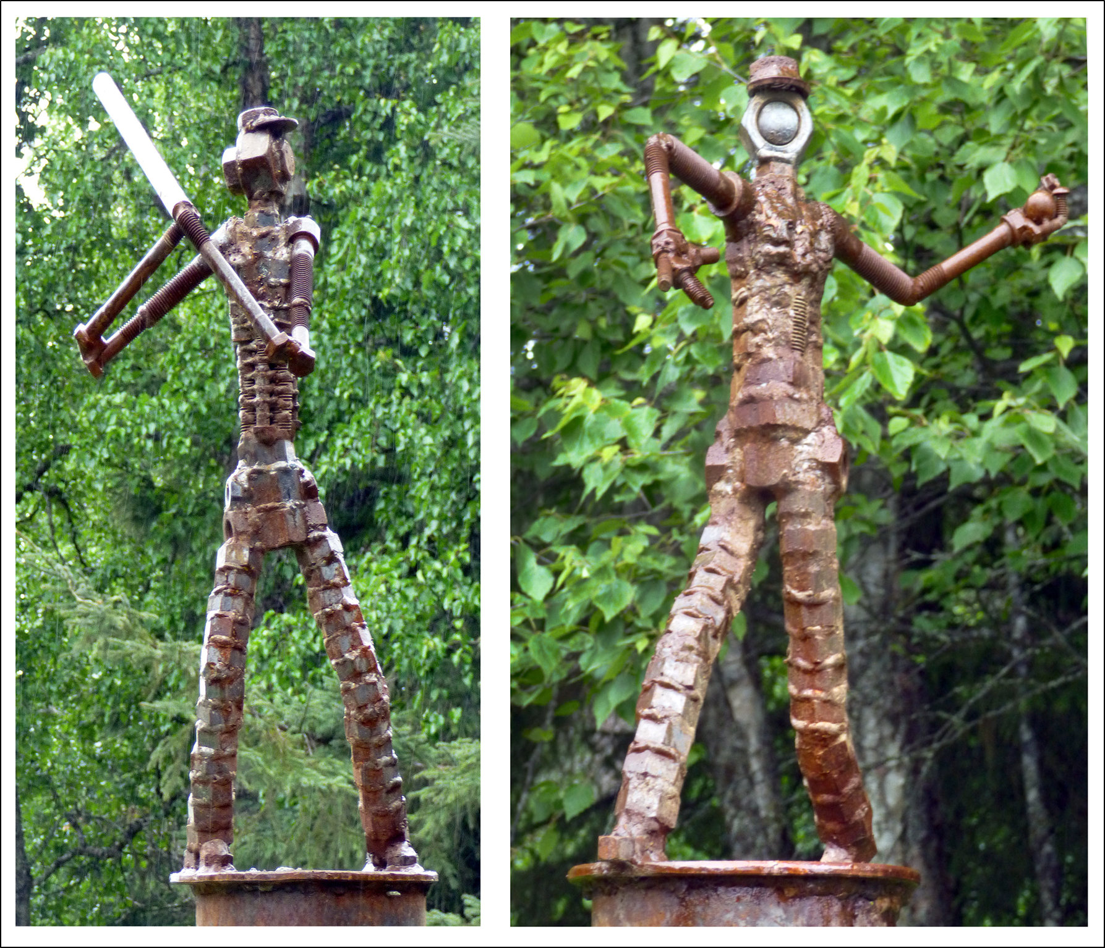

Slide 6
