Slide 1
City of Homer Municipal Art Inventory
Part 3 – Artwork located at Public Works Department, City Parks, and on City owned facilities on Pioneer Avenue and on the Homer Spit this segment includes pieces currently in storage and not on public display.
Photos and Information Prepared and Presented by
Jim Lavrakas
Far North Photography
In Collaboration with the City of Homer
Parks, Art, Recreation & Culture
Advisory Commission

Slide 2
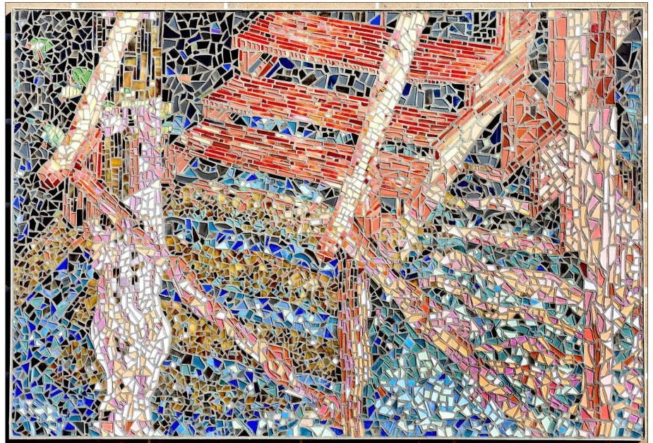
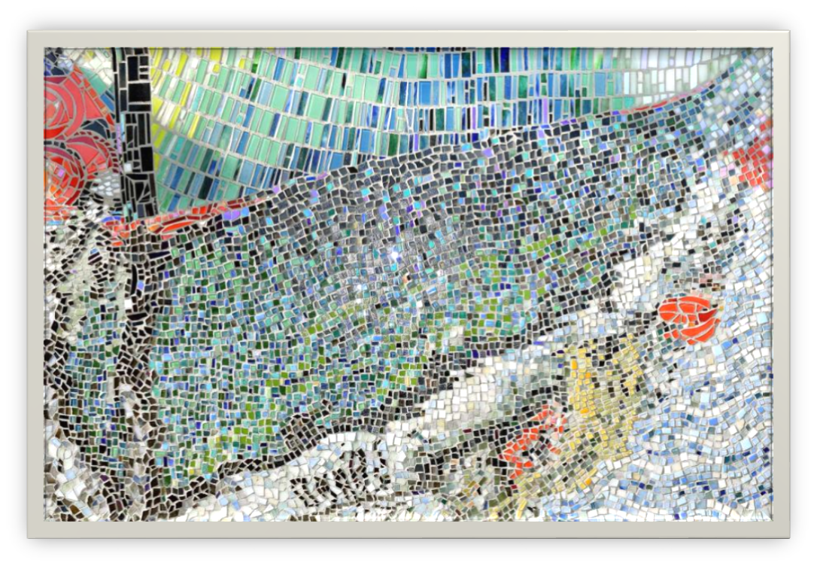

Slide 3
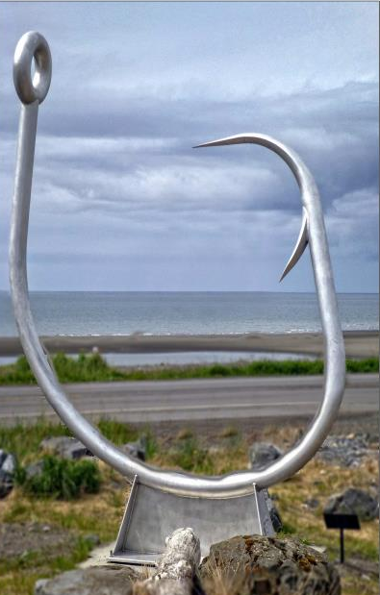

Slide 4
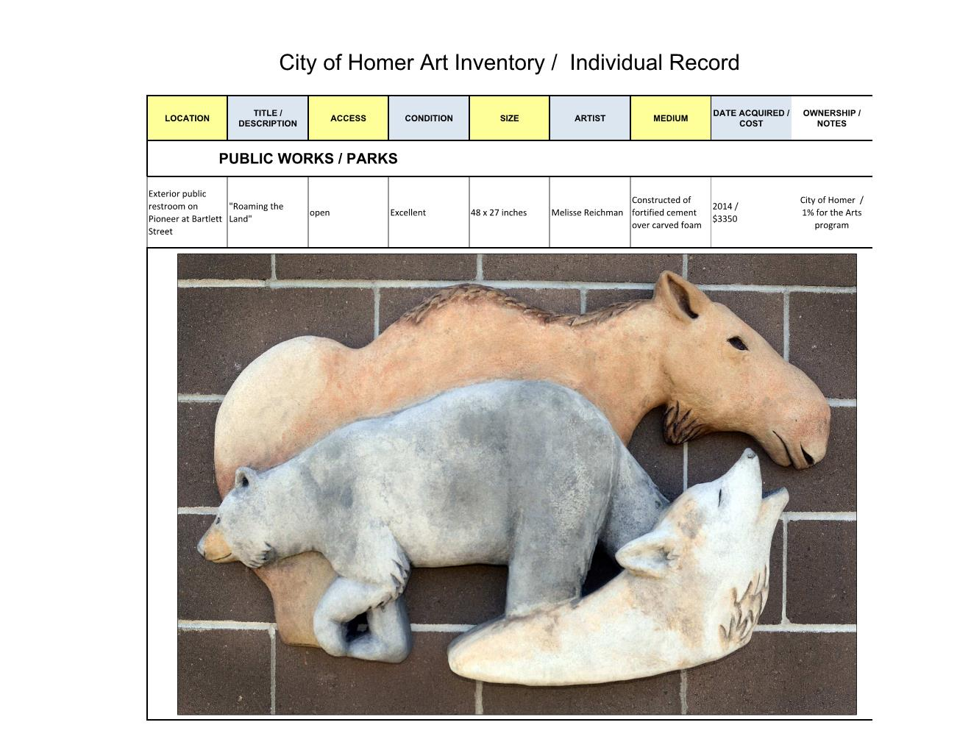
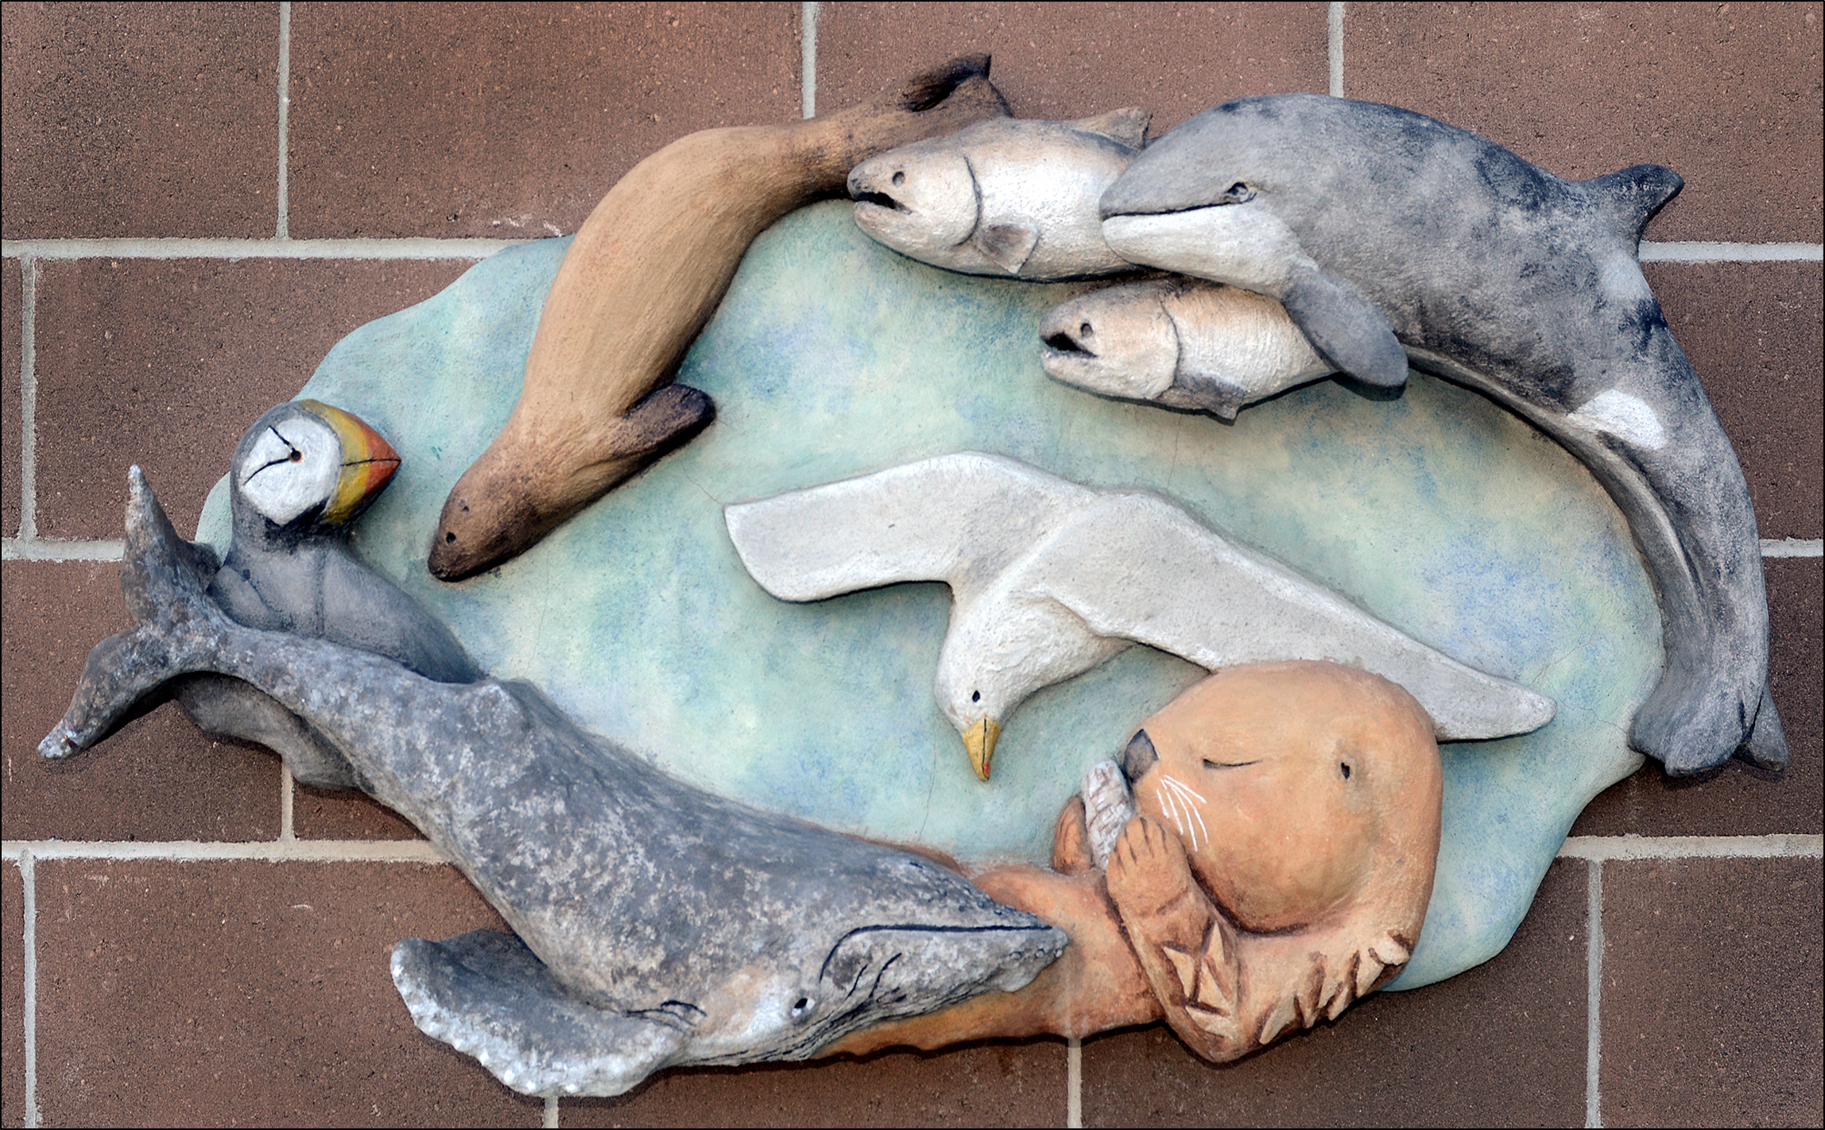

Slide 5
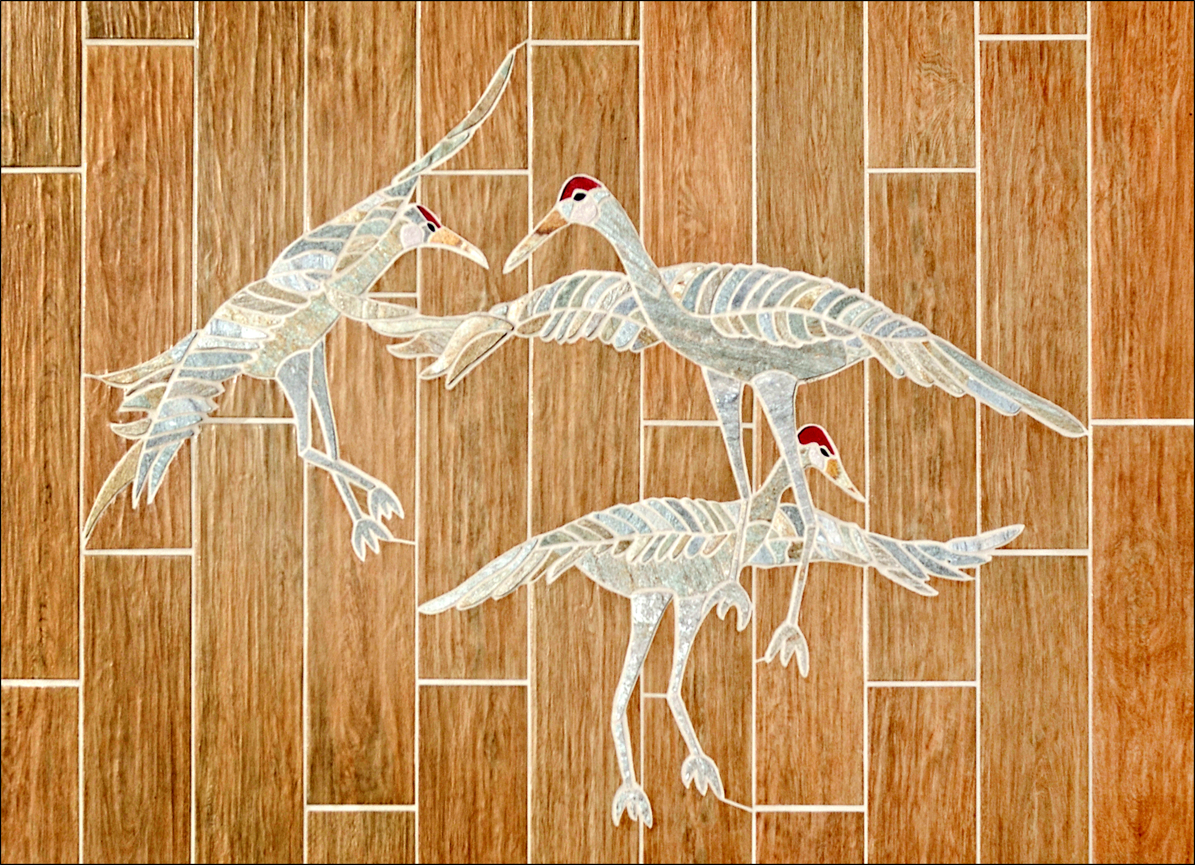
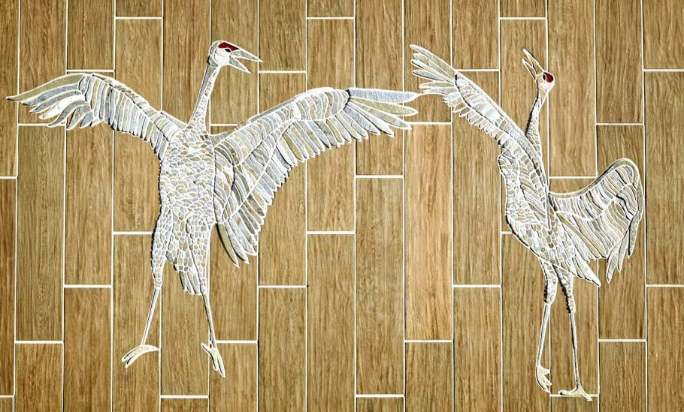

Slide 6
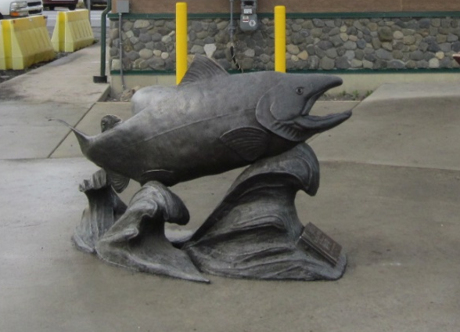

Slide 7
