Slide 1
Preliminary Results: Homer Landslide Hazard Resiliency Project
January 15, 2020
Barrett Salisbury, Ph.D.
Alaska Division of Geological & Geophysical Surveys
FEMA CTP, projected completion 09/2020
Notes:
Active Tectonics Program Manager at DGGS, work with UAF on tsunami hazard maps/updates for Homer
After a 7-month initial delay in data acquisition we are back on track to have the project completed in accordance with original timeline, September 2020
Jaci Overbeck is also here on behalf of DGGS as the Coastal Hazards Program Manager, leading a sister-CTP that follows closely on the landslide hazard project

Slide 2
Outline
Lidar acquisition, calibration, classification
Mass wasting processes
Landslide hazard assessment protocols
The landslide inventory
Preliminary Factor of Safety (FOS) map
Deep-seated landslide susceptibility map—what to expect
Debris flow runout modeling, pros and cons
Discussion and/or contact info

Slide 3
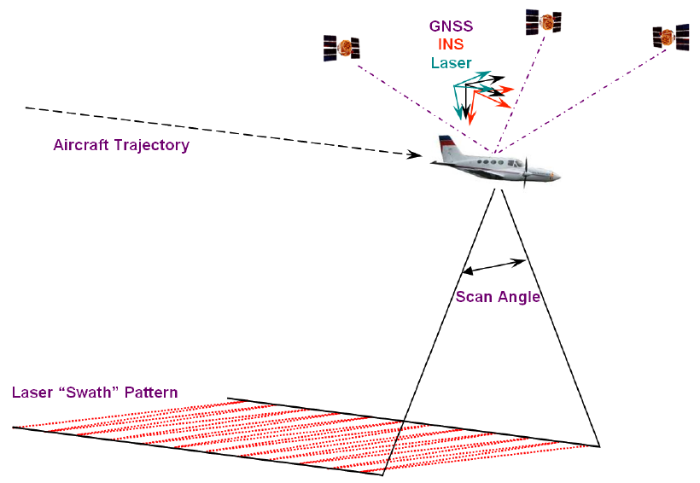
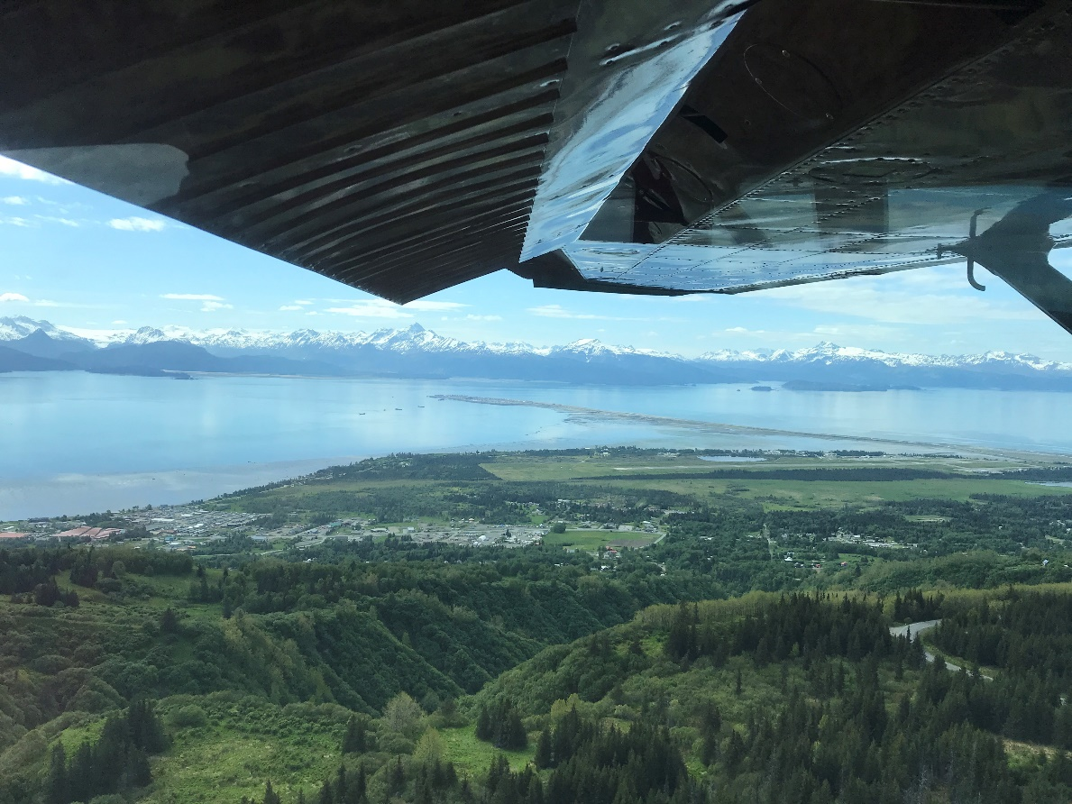
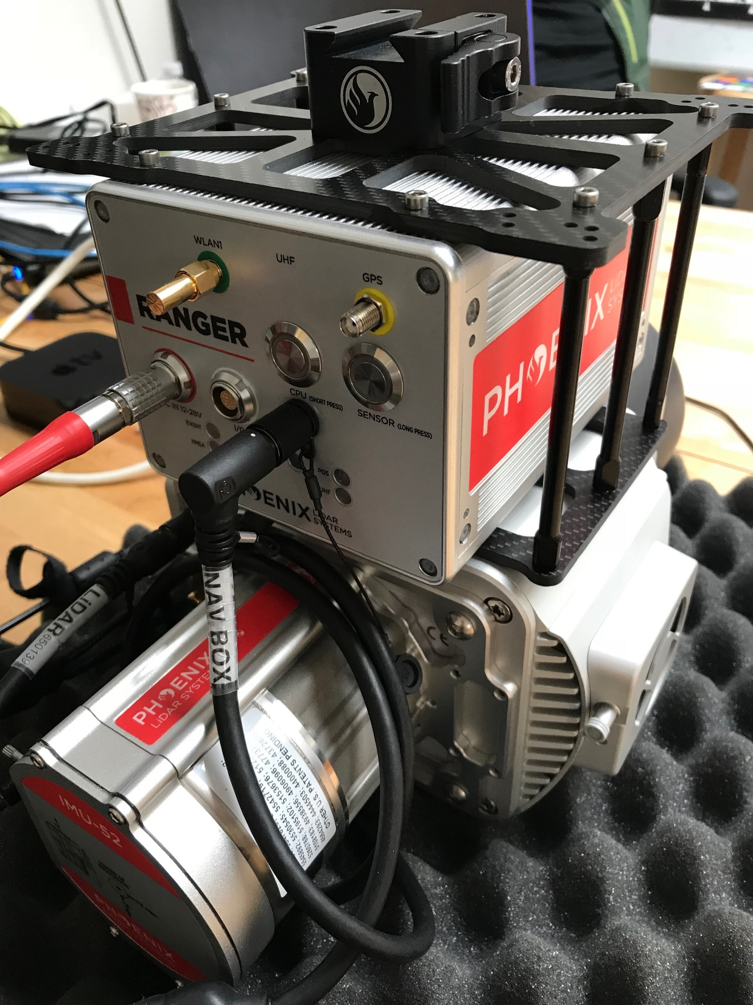
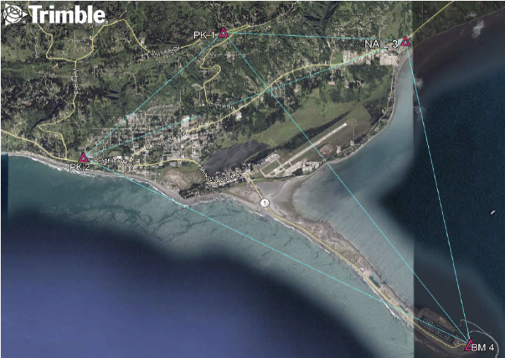
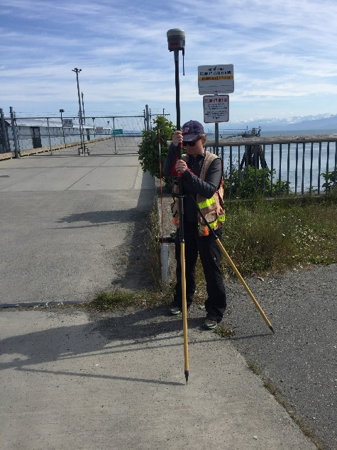
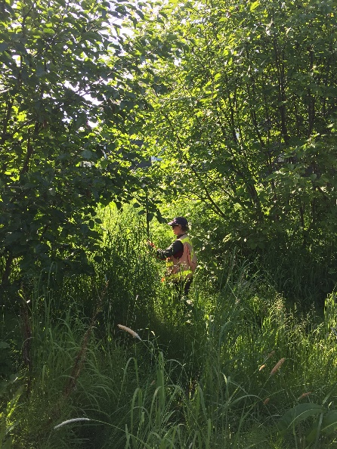
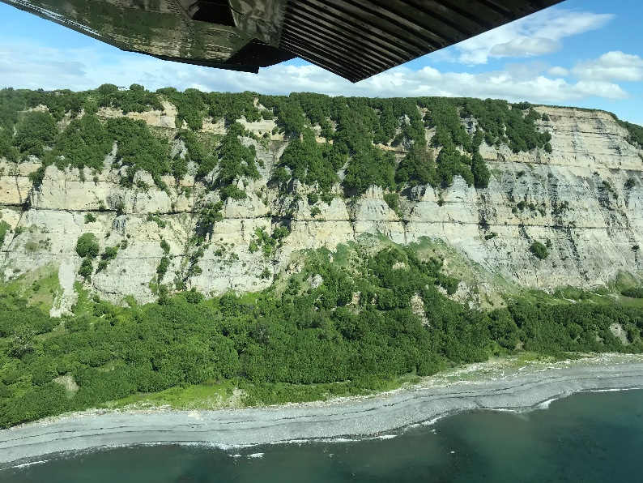
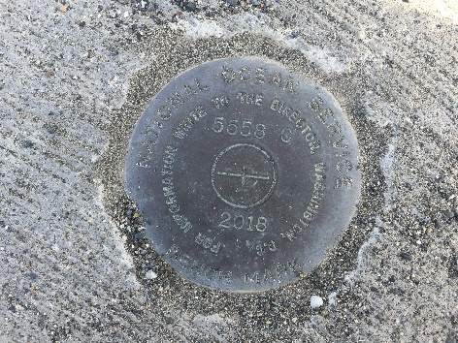
Data acquisition
June 6, 2019
Colombo et al., 2010
Notes:
Lidar = light detection and ranging data
Out-and-back technology like a Rangefinder you’d use on a golf course, but ~400,000 pulses/second for ~6 hrs
Contracted professionally certified land surveyors from the DMLW that used established benchmarks to collect check points in a range of conditions
Beautiful conditions for lidar scanning and oblique aerial photography of coastline

Slide 4
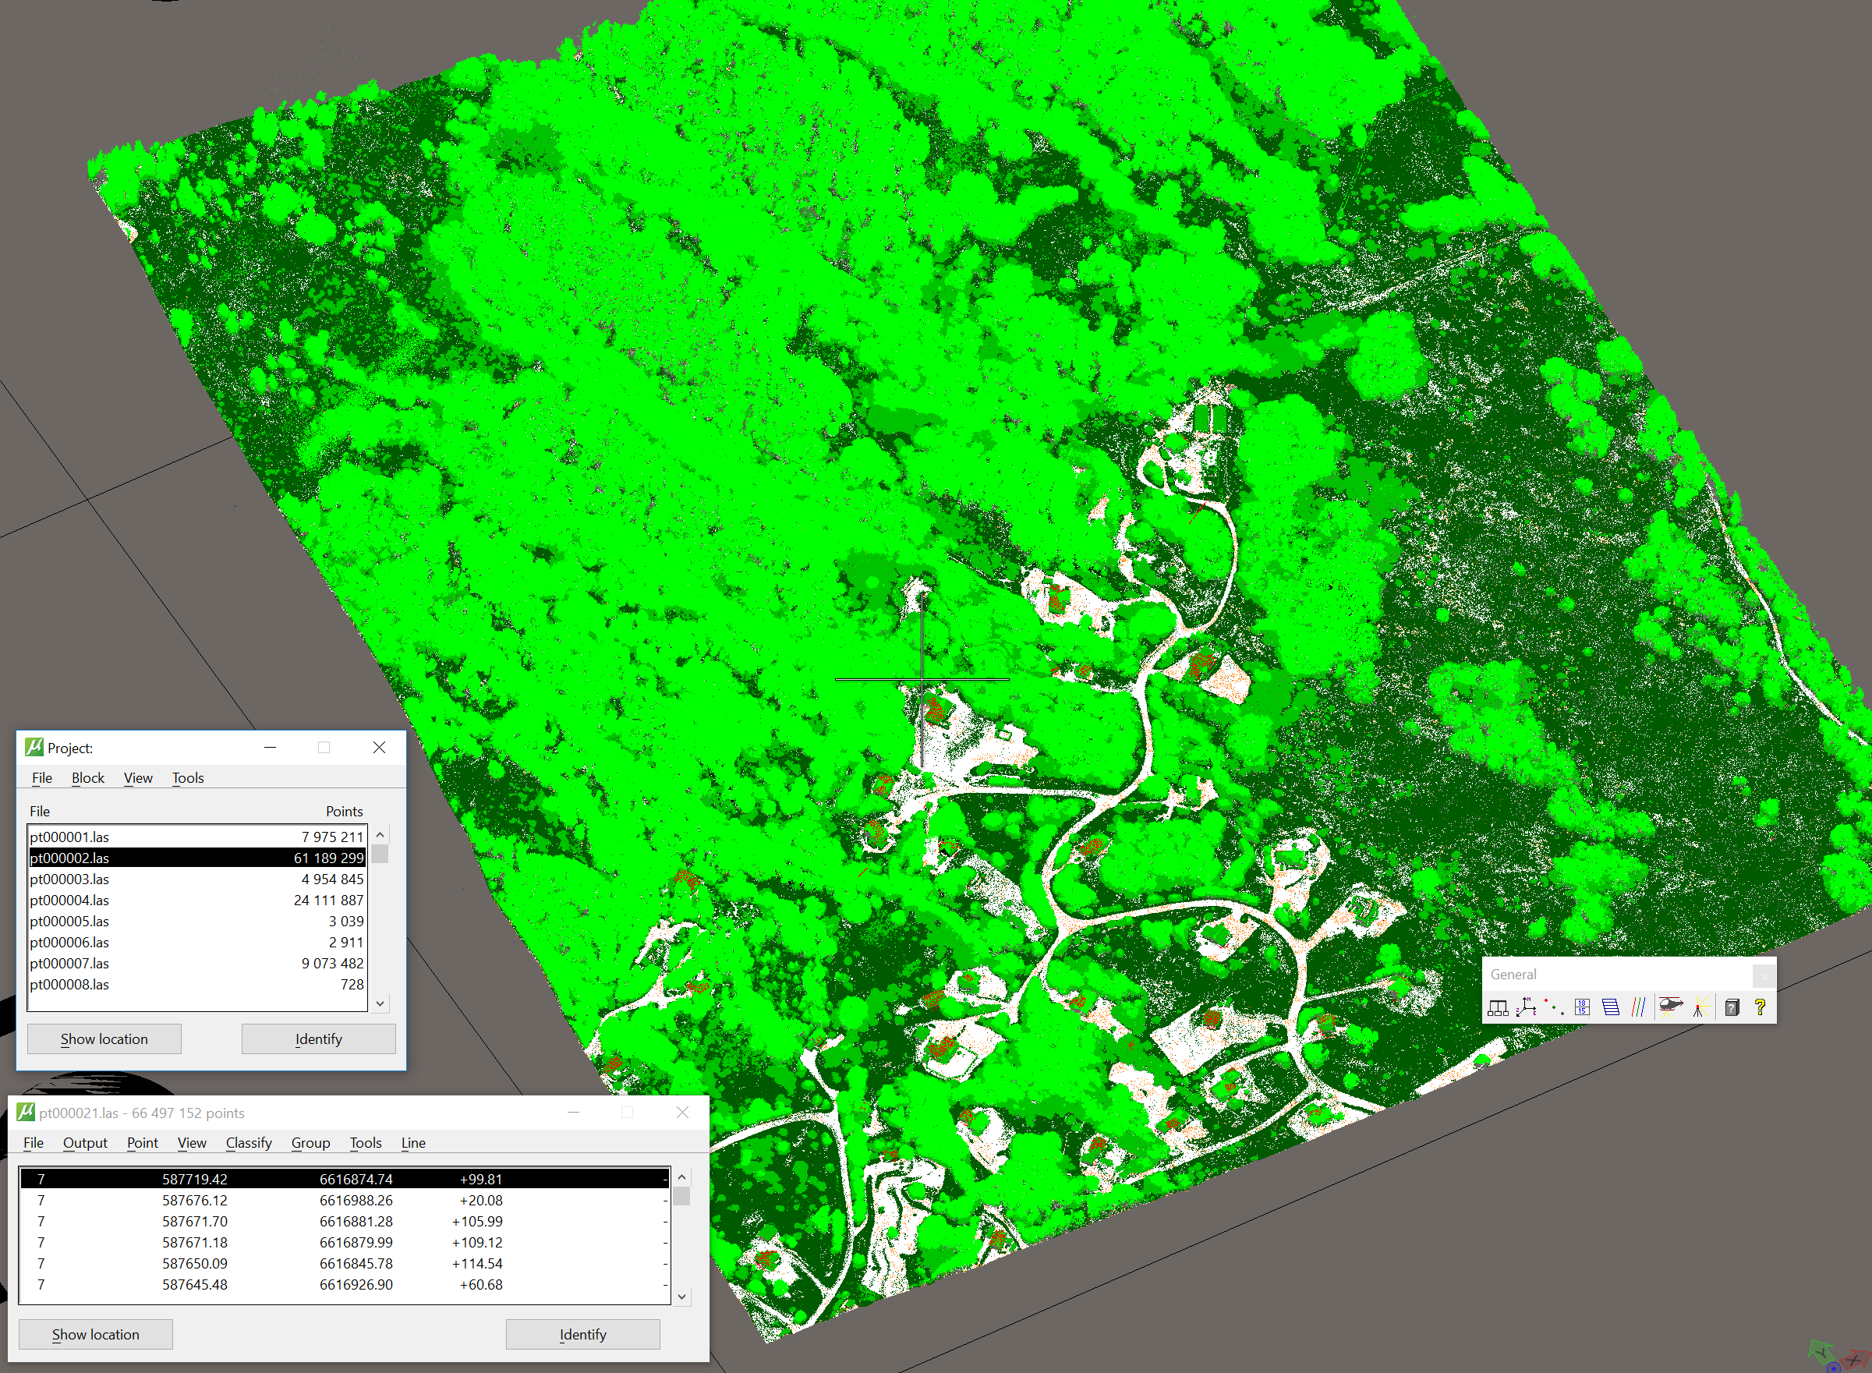
Notes:
Viewing 1 block of 210 total blocks, 61.2 million points in this block
After lidar is calibrated (correcting for airplane bumps, GPS errors) we use a series of algorithms to classify points into classes—VEG groups, GROUND, building, etc
Up to 7 returns for each pulse, so if part of the signal hits a tree, another part might still be able to reach the ground

Slide 5
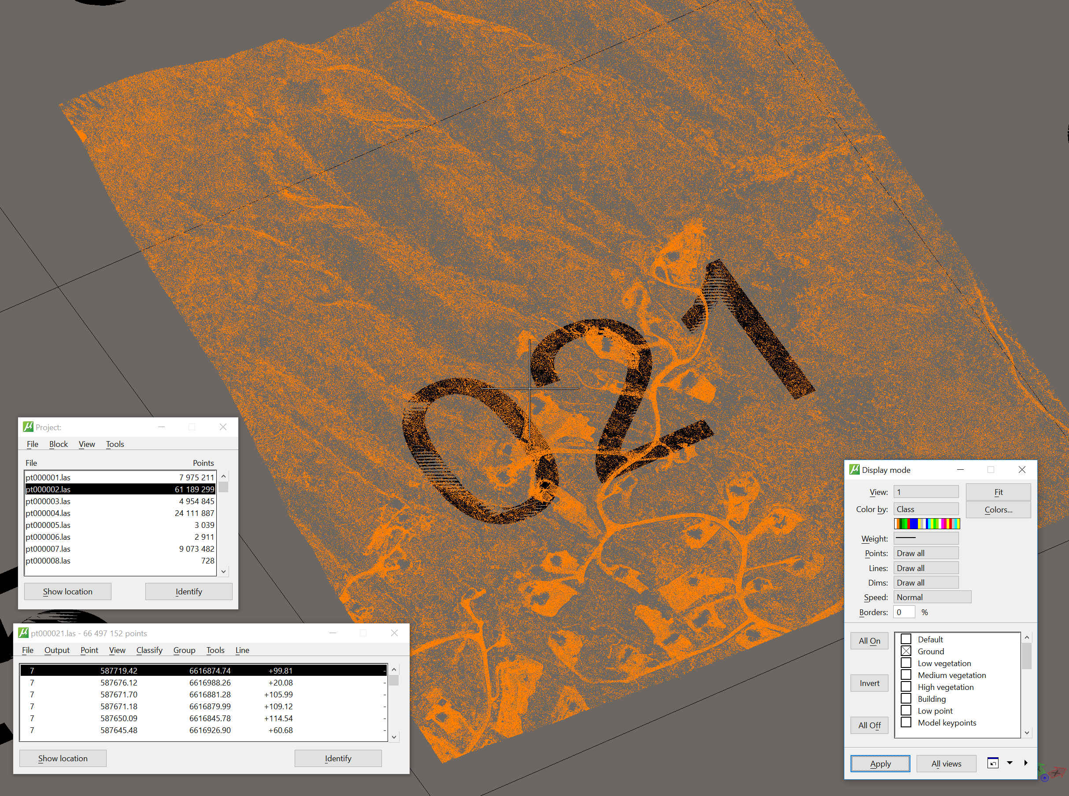
Notes:
As a geomorphologist the bare ground returns are what we are most interested in
Only a relatively small portion of the total laser pulses make it to the ground

Slide 6
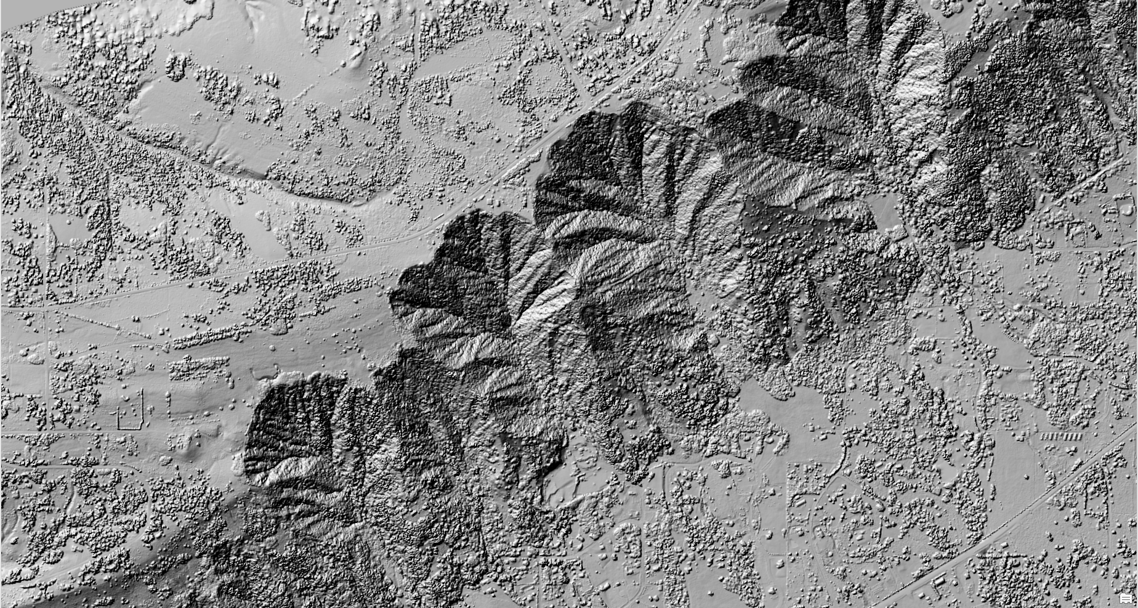
Notes:
If we interpolate a ground surface using all the points we see the trees, buildings--everything

Slide 7
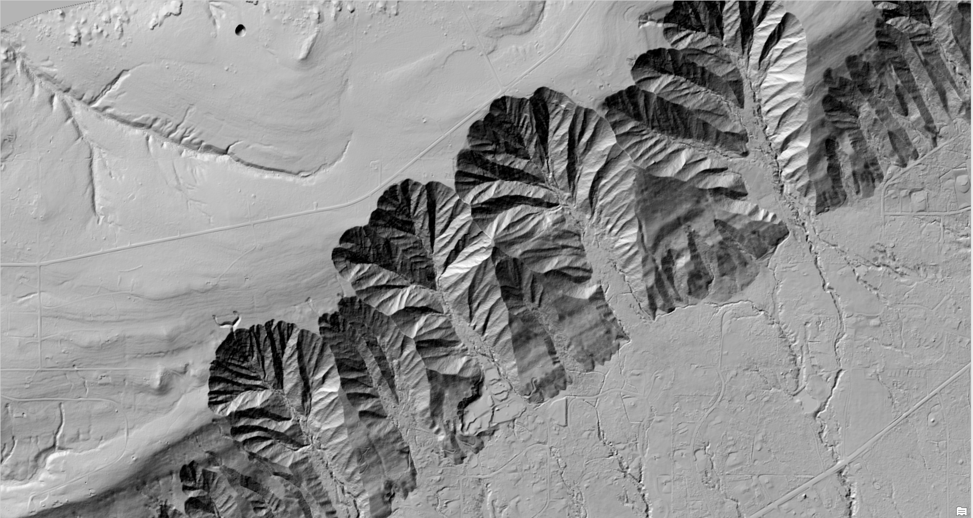
Notes:
But by utilizing just the ground returns we are able to clearly visualize landforms that otherwise wouldn’t be visible.
Enough points on the ground to make a 0.5 m resolution digital terrain model (DTM)

Slide 8
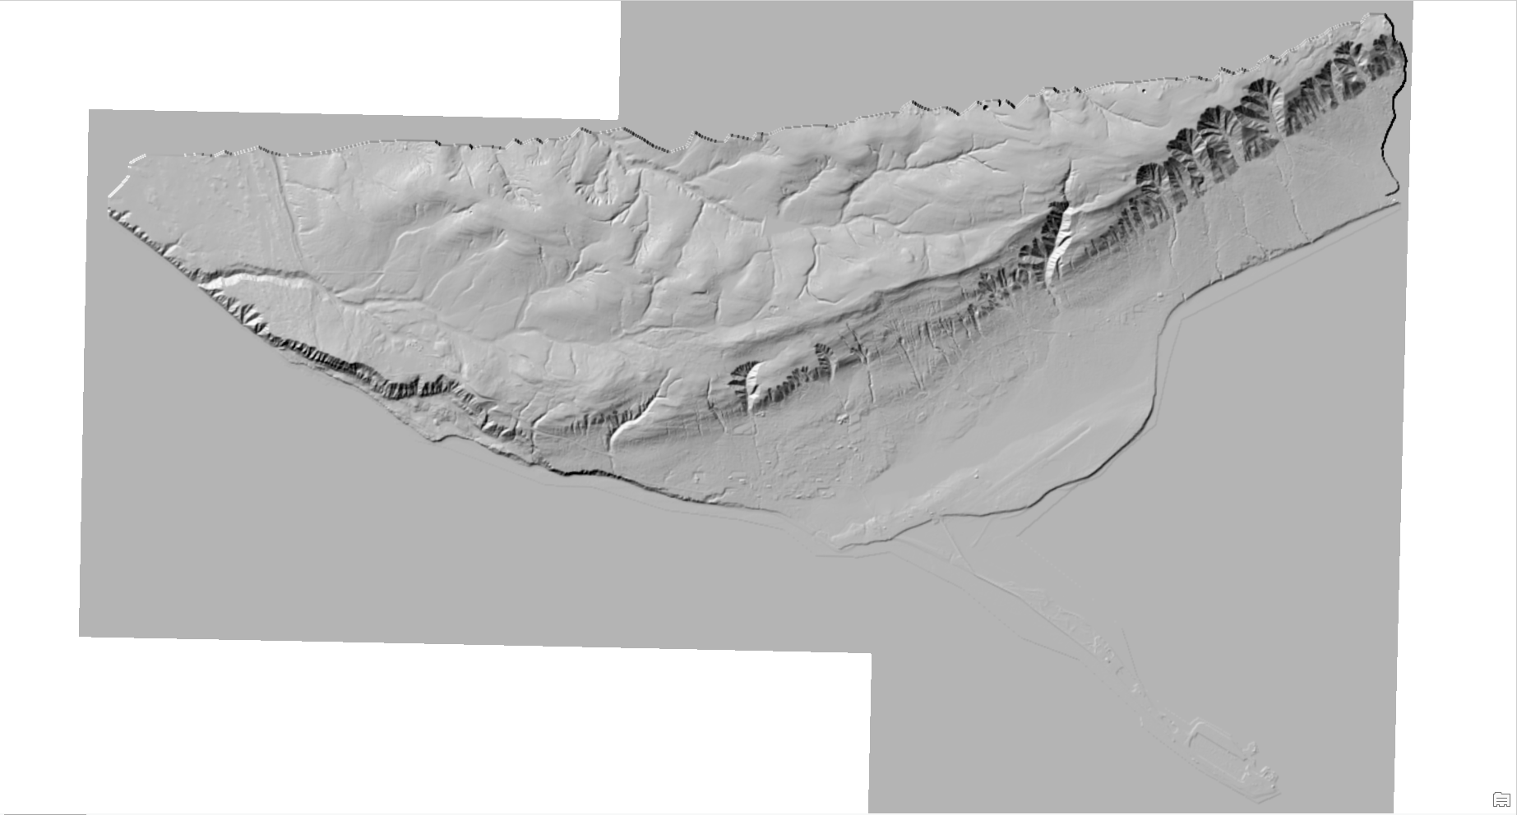
RMSEs at 95% conf.
Non-vegetated VA 2.52 cm
Vegetated VA 25.76 cm
Notes:
We then compare the ~100 points from the professional surveyors from different areas on the ground (unvegetated, low shrubs, tall trees) to assess our errors in the elevation model
The stationary ground survey is the higher-quality standard to which we compare our airborne survey
95 percent of the time, when we make the comparison between datasets,
for non-vegetated areas, our scan is at max 2.52 cm from their survey
For the vegetated areas, on average our scan is at max 25.76 from their survey

Slide 9
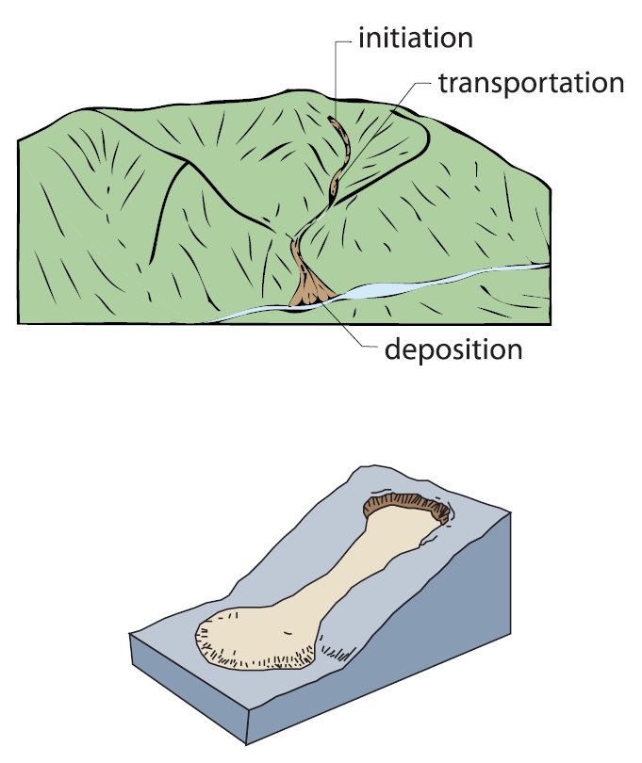
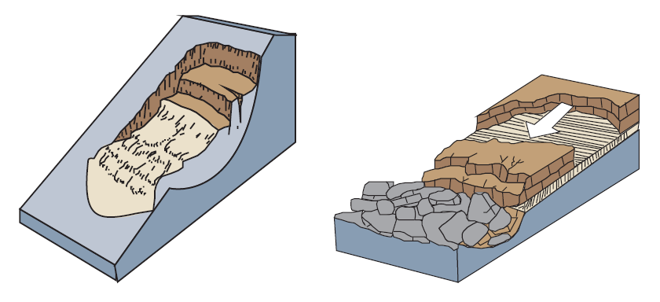
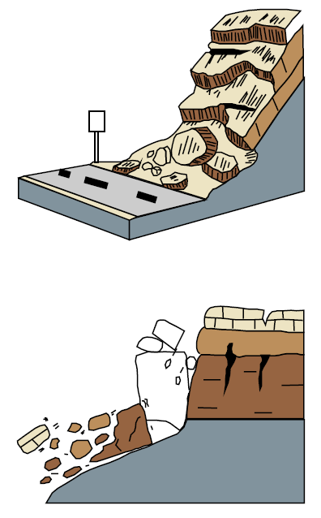
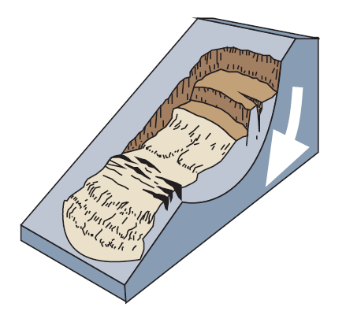
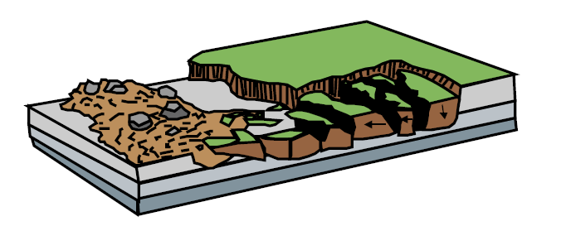
“slides”
Debris flows
falls/topples
complex
spreads
illustrations from DOGAMI
Notes:
“Landslide” is a catch-all term, but it is not always appropriate for discussions of “mast wasting,” which is the gravity-driven down-slope movement of material
Traditional “slides” move along a failure plane, curved plane = rotational slide, flat plane = translational slide
Falls/topples are straightforward
Spreads are predominately lateral movements, and are most commonly associated with liquefaction of underlying layers
Homer predominately faces hazards from flows – channelized debris flows and earth flows when soils become saturated and unstable (will show examples of these in a few slides)
Lastly, is the second most common, complex landslides that utilize a failure plane but also include characteristics of other types of mass wasting events. Homer has a very large, famous one of these (the Bluff Point landslide) that we will discuss

Slide 10
Notes:
To outline the hazards using high-resolution topographic data we follow protocols designed by DOGAMI.
Following three main protocols will ideally produce a standard set of results, regardless of the researcher
The landslide inventory complete with landslide characteristics where decipherable
A shallow landslide susceptibility map (also known as a FOS map), that will outline the debris flow hazards for Homer
And a deep-seated landslide susceptibility map that highlights areas of known slope failures that tend to fail successively/progressively over geologic time.

Slide 11
Notes:
This is an image of the preliminary landslide inventory.
Contains over 1,000 individual debris flows, both channelized DF and earthflows
Difficult to see until I zoom in, but the green/orange/red are slope failures of known relative age, and the pink lines are ones with uncertain age data
The majority of mapped slides are in the steeper areas
The southwest edge of the data contains the bluff point landslide

Slide 12
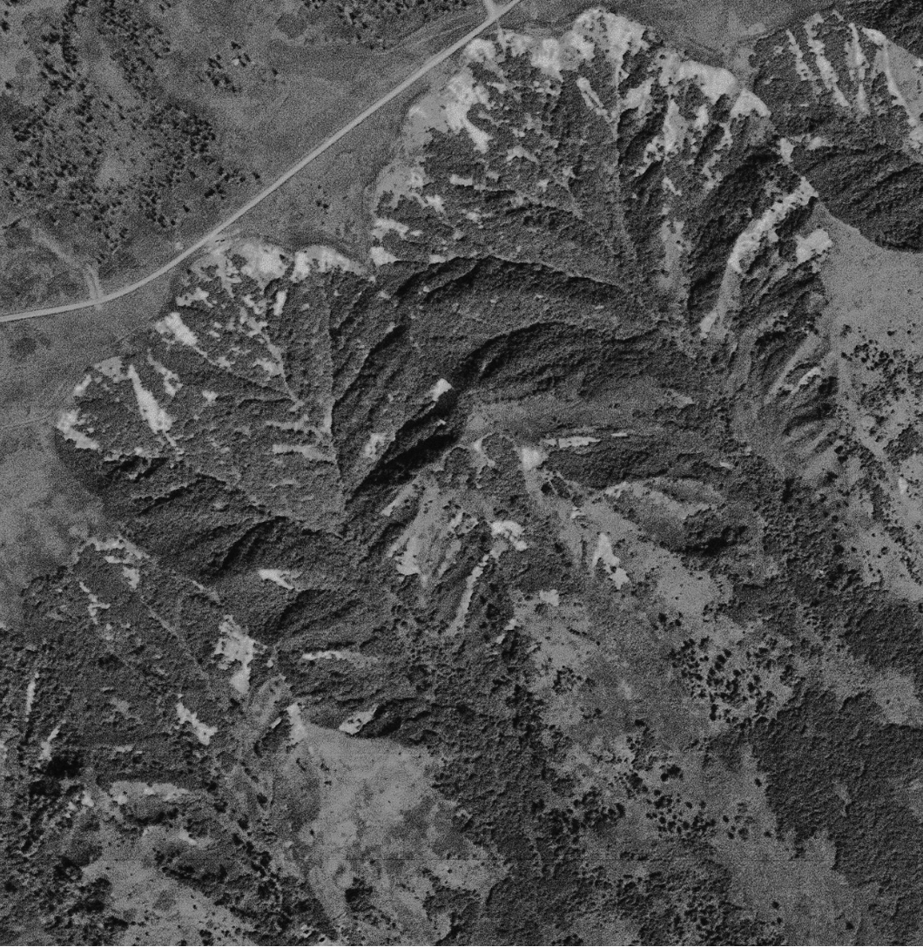
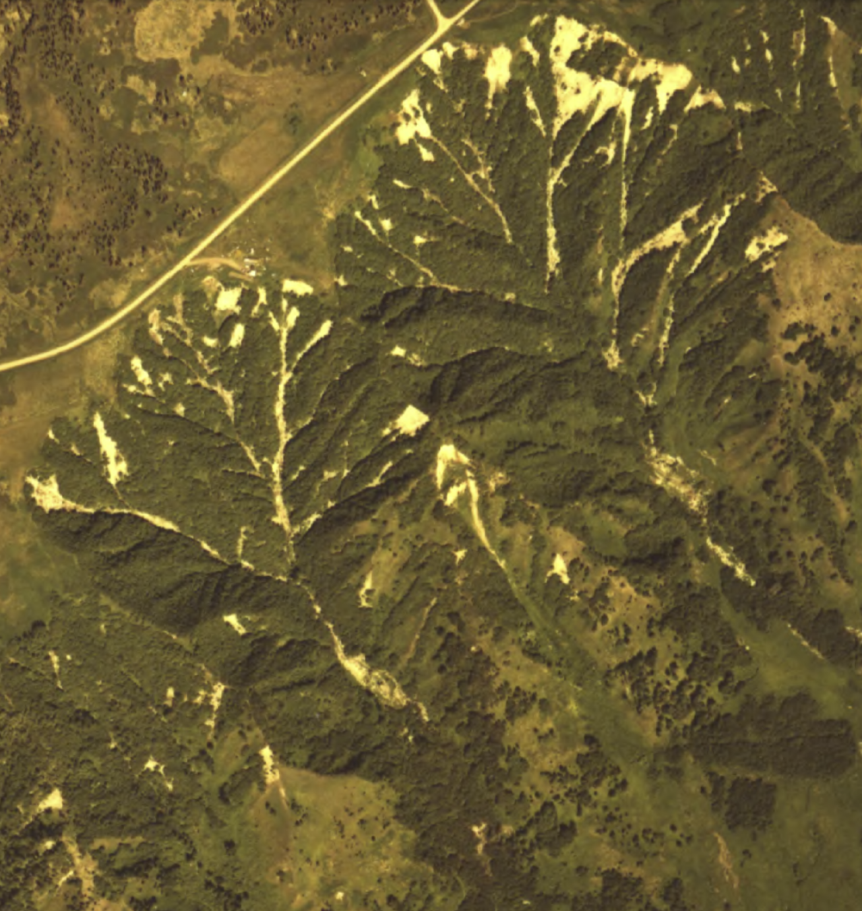
1952
1975
Notes:
Example of how I used repeat aerial photography to document where these debris flows have occurred
1952 is earliest set of air photos for Homer, and the next set of photos are in 1975

Slide 13
Notes:
1952, 1975, Mid 1980’s, 2000, 2013, 2016
This is what a closeup of the landslide inventory map will look like and there will be an associated table database with information about each of these
When it happened
What type of movement it was
The slope angle from which it originated…

Slide 14
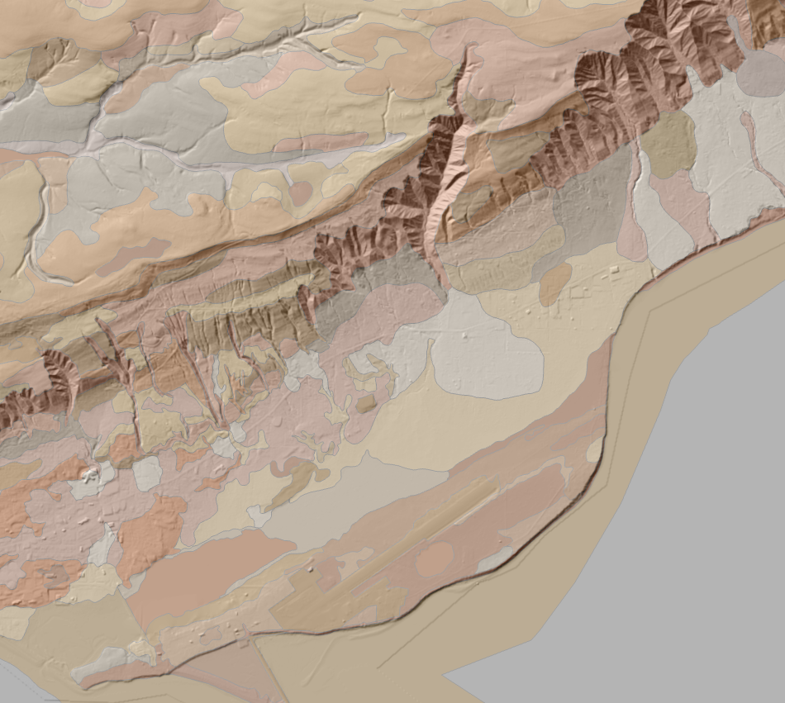
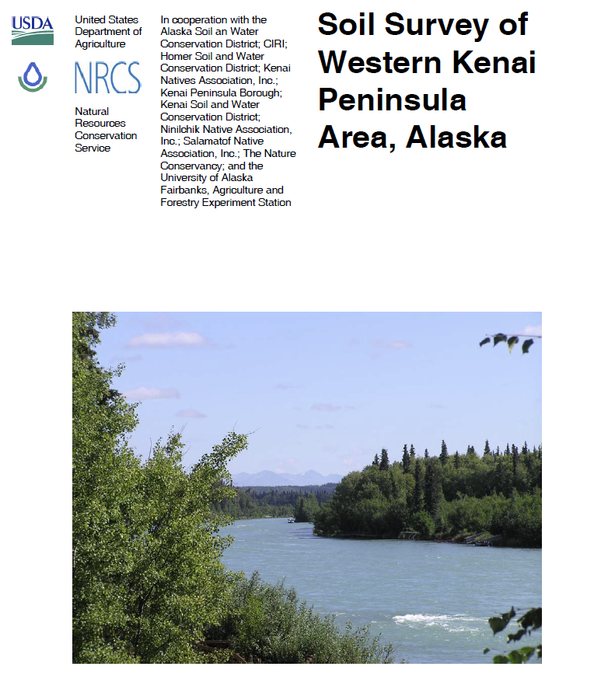
Notes:
Primary input for the FOS map is slope, which we derive from our new elevation model and soil characteristics, which have been mapped by the US Dept. of Agriculture
One main geologic unit here known as the Kenai Formation and for this study, there about 14 classifiable soils in the Homer area
The main characteristic we are interested in is how dense the soil is and how much water it can hold when it is saturated

Slide 15
*
“Highly”
unstable
“moderately”
unstable
*includes assumptions, i.e., SATURATED SOILS
Notes:
FOS is simply a ratio of resisting forces (things holding the soil in place) vs. driving forces (things pulling the soil down hill)
Resisting forces include the cohesion of the soil, angle of internal friction (dependent upon the shapes of the particles)
Driving forces include how heavy the soil gets when it is saturated, how steep the slope is
We assume several things, the most important of which is that the soil column (which is about 5’ into the ground) is saturated with water.
This is on purpose, so that we are “extra careful”
When the forces balance perfectly, we have a critically stable slope--FOS = 1--which would potentially be let loose by the smallest disturbance (tiny EQ, for example)
>1 is technically stable, but engineers typically use a buffer of 0.5, such that they only consider slopes with a FOS >1.5 as stable because of uncertainties in that formula
<1, the driving forces are stronger than resisting forces and the slope fails
Predominately slope-driven hazard map.

Slide 16
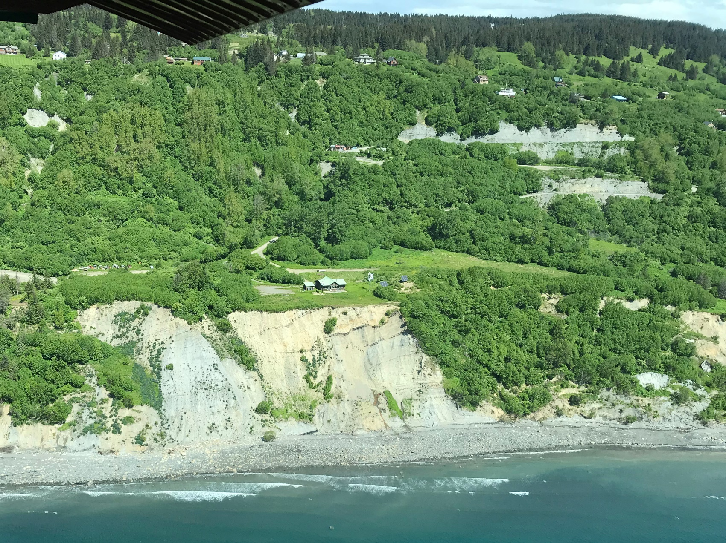
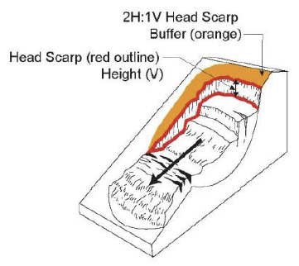
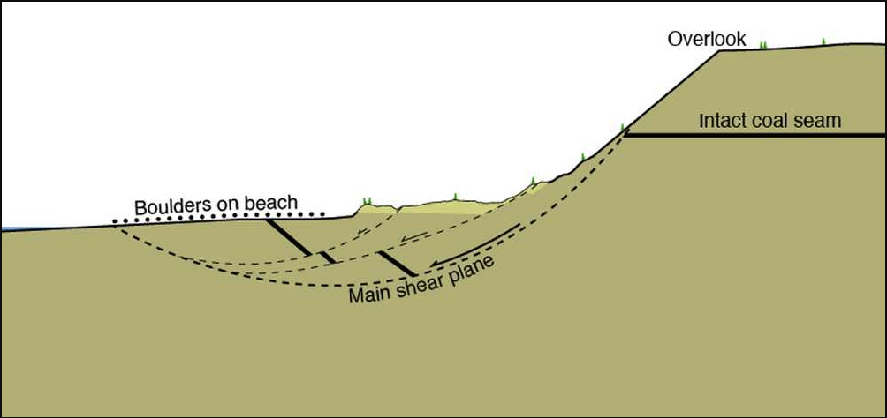
~2,250 yrs ago
From Berg and others, Peninsula Clarion, 2014
Notes:
Bluff point landslide, occurred ~2,250 years ago.
Complex, deep-seated rotational landslide, important to know what to expect on an upcoming hazard map
Deep-seated landslide hazard protocol includes measuring the height of the main slide scarp, and then doubling that height and using it as a setback from the scarp because these types of slope failures typically happen progressively
Deep-seated landslides are completely unpredictable, but the existence of one is the biggest indicator that there may be future slope failures.

Slide 17
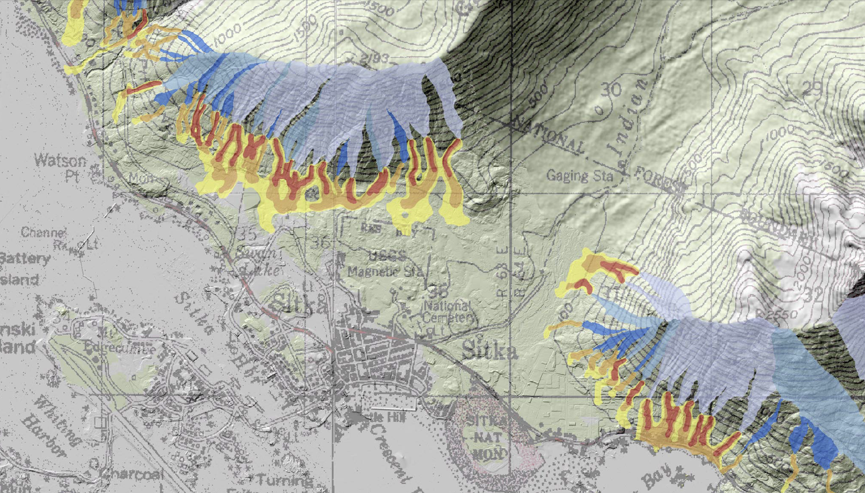
Notes:
Highly speculative debris-flow runout modeling. Developed to model volcanic mudflow runouts…
Good and bad, but we have few examples to go on and that means for more uncertainty in our models…

Slide 18
Notes:
The terrestrial FOS analysis, and the deep-seated landslide analysis highlight the entire coastline as hazardous, and an area with high potential for landslides
Combining those hazards with coastal processes makes the instability of the coastline more complex than what can be addressed with the DOGAMI protocols alone
--> Coastal bluff study

Slide 19
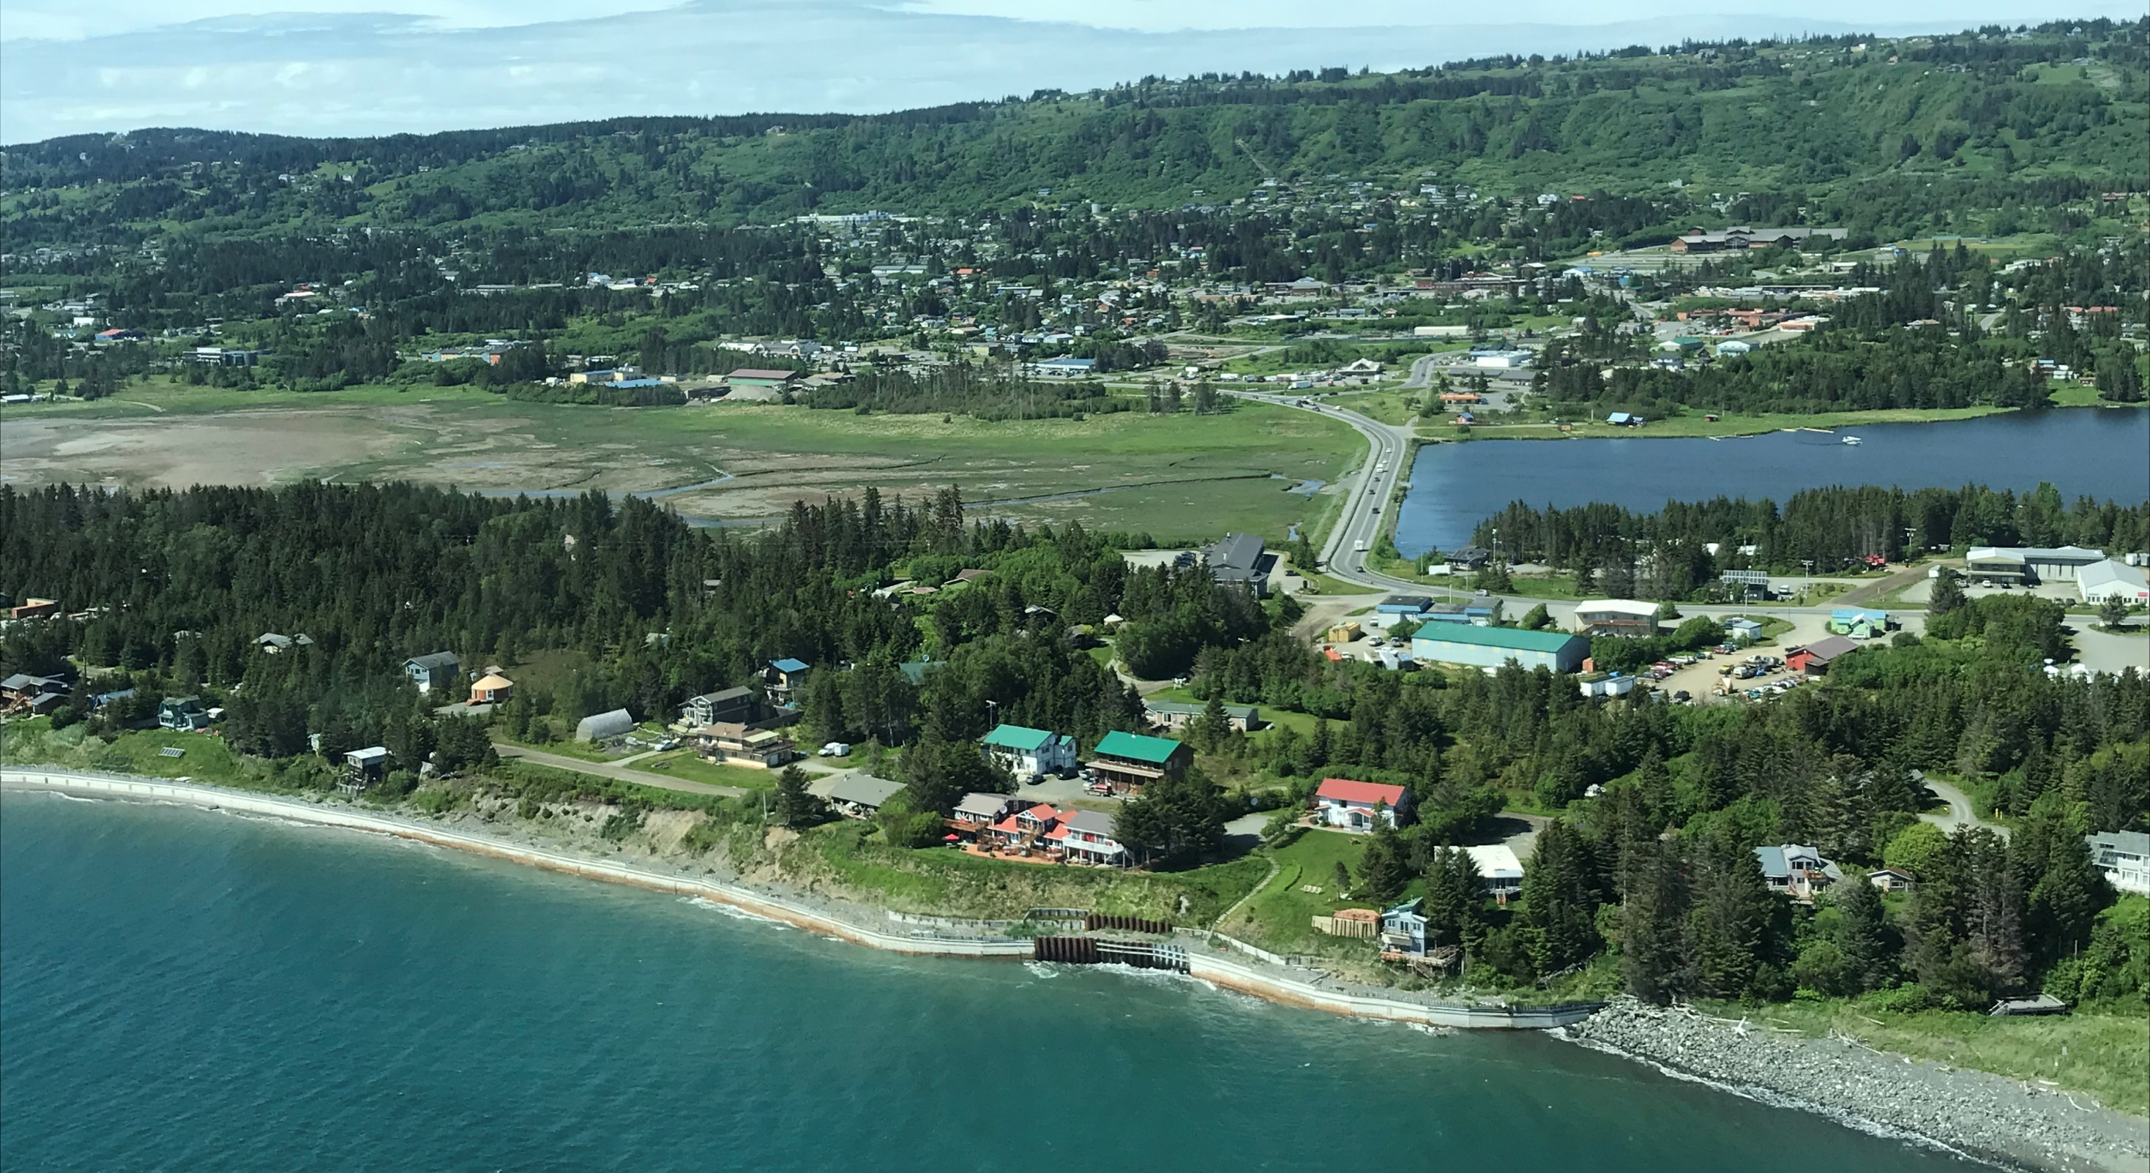
COASTAL BLUFF STABILITY MAPPING
HOMER ALASKA
HOMER PLANNING COMMISSION MEETING
JANUARY 15, 2019
JACQUELYN OVERBECK
STATE OF ALASKA
DIVISION OF GEOLOGICAL & GEOPHYSICAL SURVEYS

Slide 20
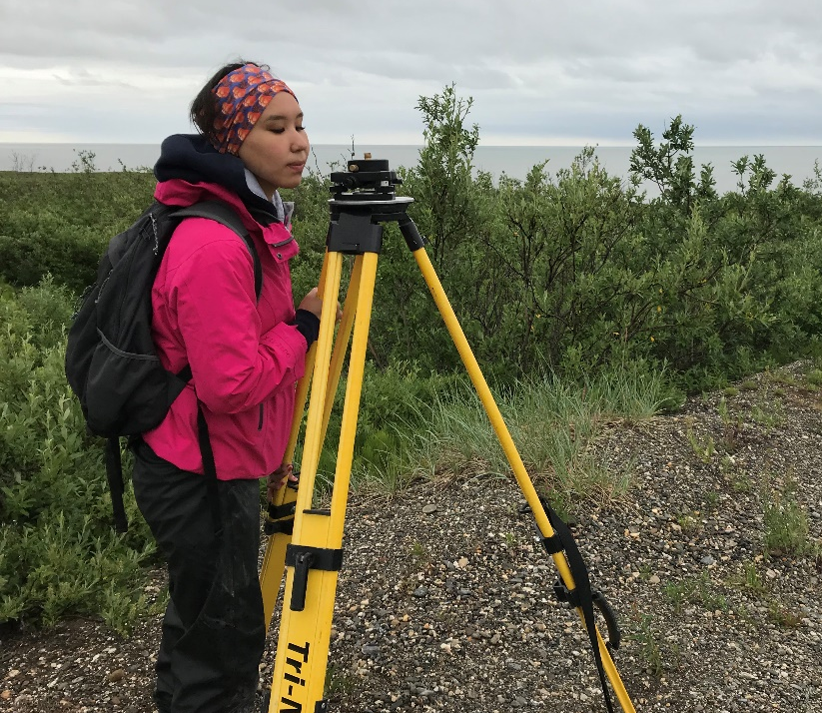
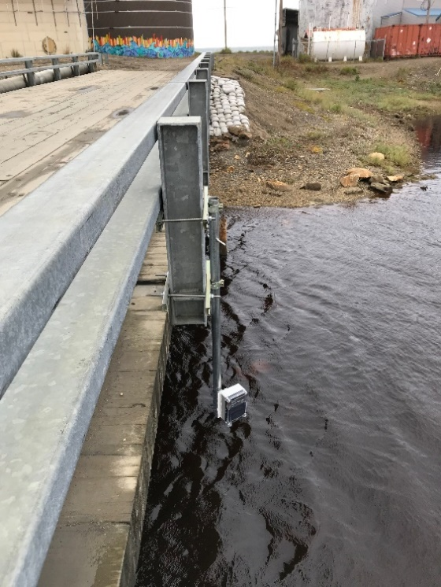
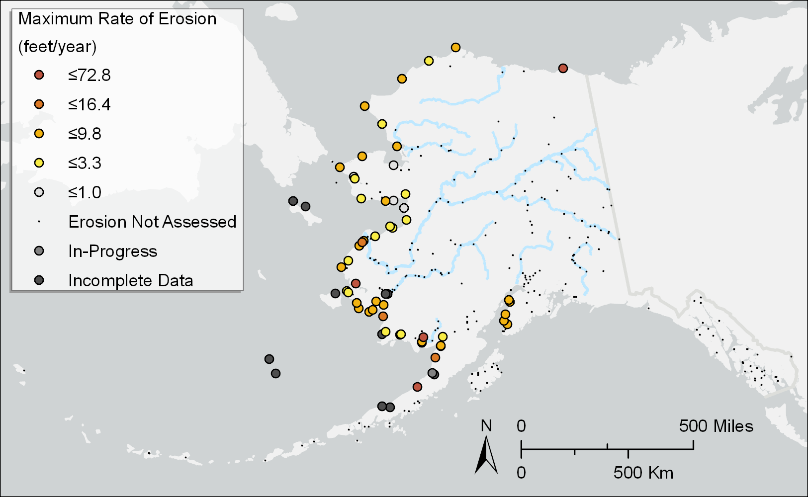
ALASKA DGGS COASTAL HAZARDS MAPPING
Dept. Natural Resources, Division of Geological & Geophysical Surveys
Our mission: Determine the potential of Alaskan land for production of metals, minerals, fuels, and geothermal resources, the locations and supplies of groundwater and construction material, and the potential geologic hazards to buildings, roads, bridges, and other installations and structures (AS 41.08.020).
Coastal Hazards Program
Mapping, Monitoring, and Modeling Coastal Flood and Erosion Hazards
Kotzebue
Deering
Mapping
Monitoring
Modeling
STATE OF ALASKA
DIVISION OF GEOLOGICAL & GEOPHYSICAL SURVEYS

Slide 21
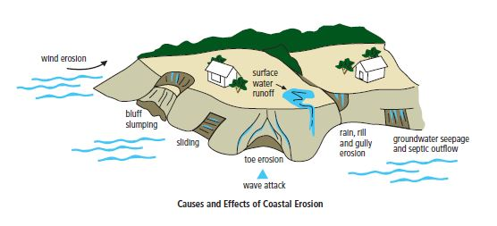
INTRODUCTION TO COASTAL BLUFF STABILITY PROJECT
The landslide project highlights the entire coastline as having landslide potential, what additional information can be used to assist decision making for coastal erosion? And how can we format data for use by the City of Homer and the Homer Planning Commission?
Terrestrial
(Landslide susceptibility, slope failures, vegetative cover, etc.)
+
Oceanographic
(Historical/recent shoreline change rates, distance waves travel to reach bluff materials, etc.)
Coastal Bluff Stability Mapping
Products for Decision Making:
Mapping coastal features relevant to permitting and City Zoning Code.
STATE OF ALASKA
DIVISION OF GEOLOGICAL & GEOPHYSICAL SURVEYS

Slide 22
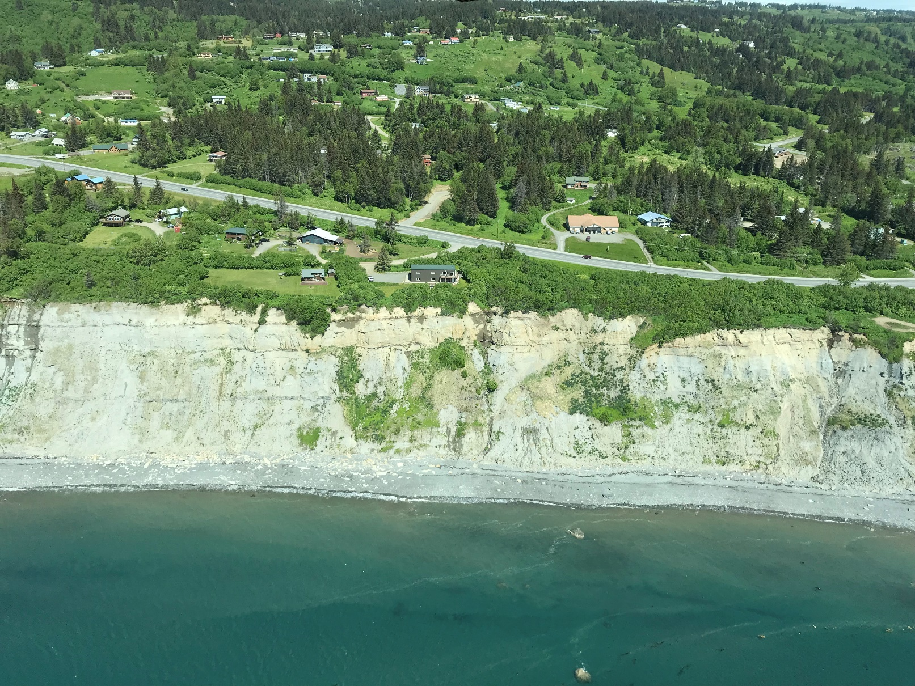
INTRODUCTION TO COASTAL BLUFF STABILITY PROJECT
Using lidar to map coastal features in alongshore segments, which can then provide the basis by which to permit or zone land use.
Distance to Infrastructure
Bluff Crest
Nearest
Infrastructure
Elevation Above Mean High Water (MHW)
Bluff Face Slope
MHW Elevation
Bluff Toe
Distance to Bluff Toe
Distance Cross-shore
STATE OF ALASKA
DIVISION OF GEOLOGICAL & GEOPHYSICAL SURVEYS

Slide 23
INTRODUCTION TO COASTAL SETBACK CODES
States around the US that participate in the federal Coastal Zone Management Act have developed a variety of ways to zone and code for coastal erosion threats:
Alabama—regulations require a permit for (1) removing primary dune or beach sands and vegetation or otherwise altering the primary dune system, (2) constructing any new structure, or (3) making any substantial improvement to any existing structure on property between the mean high tide and the “construction control line.”
Delaware—The building line is the state minimum setback requirement. It is defined in terms of certain distances, depending on the area, landward of a contour above the water line. It is set forth on maps the DNREC prepares with reference to a commonly used vertical datum.
Florida—permit applications by forecasting the seasonal high-water line 30 years from the date of the permit application. Line of jurisdiction is the 50-foot setback line.
Georgia—50-foot setback that applies to the upland component of the project as measured horizontally inland from the coastal marshland.
Hawaii—generally establishes shoreline setbacks between 20 and 40 feet inland from the shoreline (mean high tide line).
Maryland—100-foot setbacks from the mean high water line along tidal waters and tidal wetlands. In a “resource conservation area,” area characterized by nature-dominated environments (e.g., wetlands, forests, abandoned fields and resource-utilization activities), there is a 200-foot minimum setback.
And so on. This information was taken from Coastline Construction Restrictions by Mark Randall and Hendrik deBoer, 2012.
STATE OF ALASKA
DIVISION OF GEOLOGICAL & GEOPHYSICAL SURVEYS

Slide 24
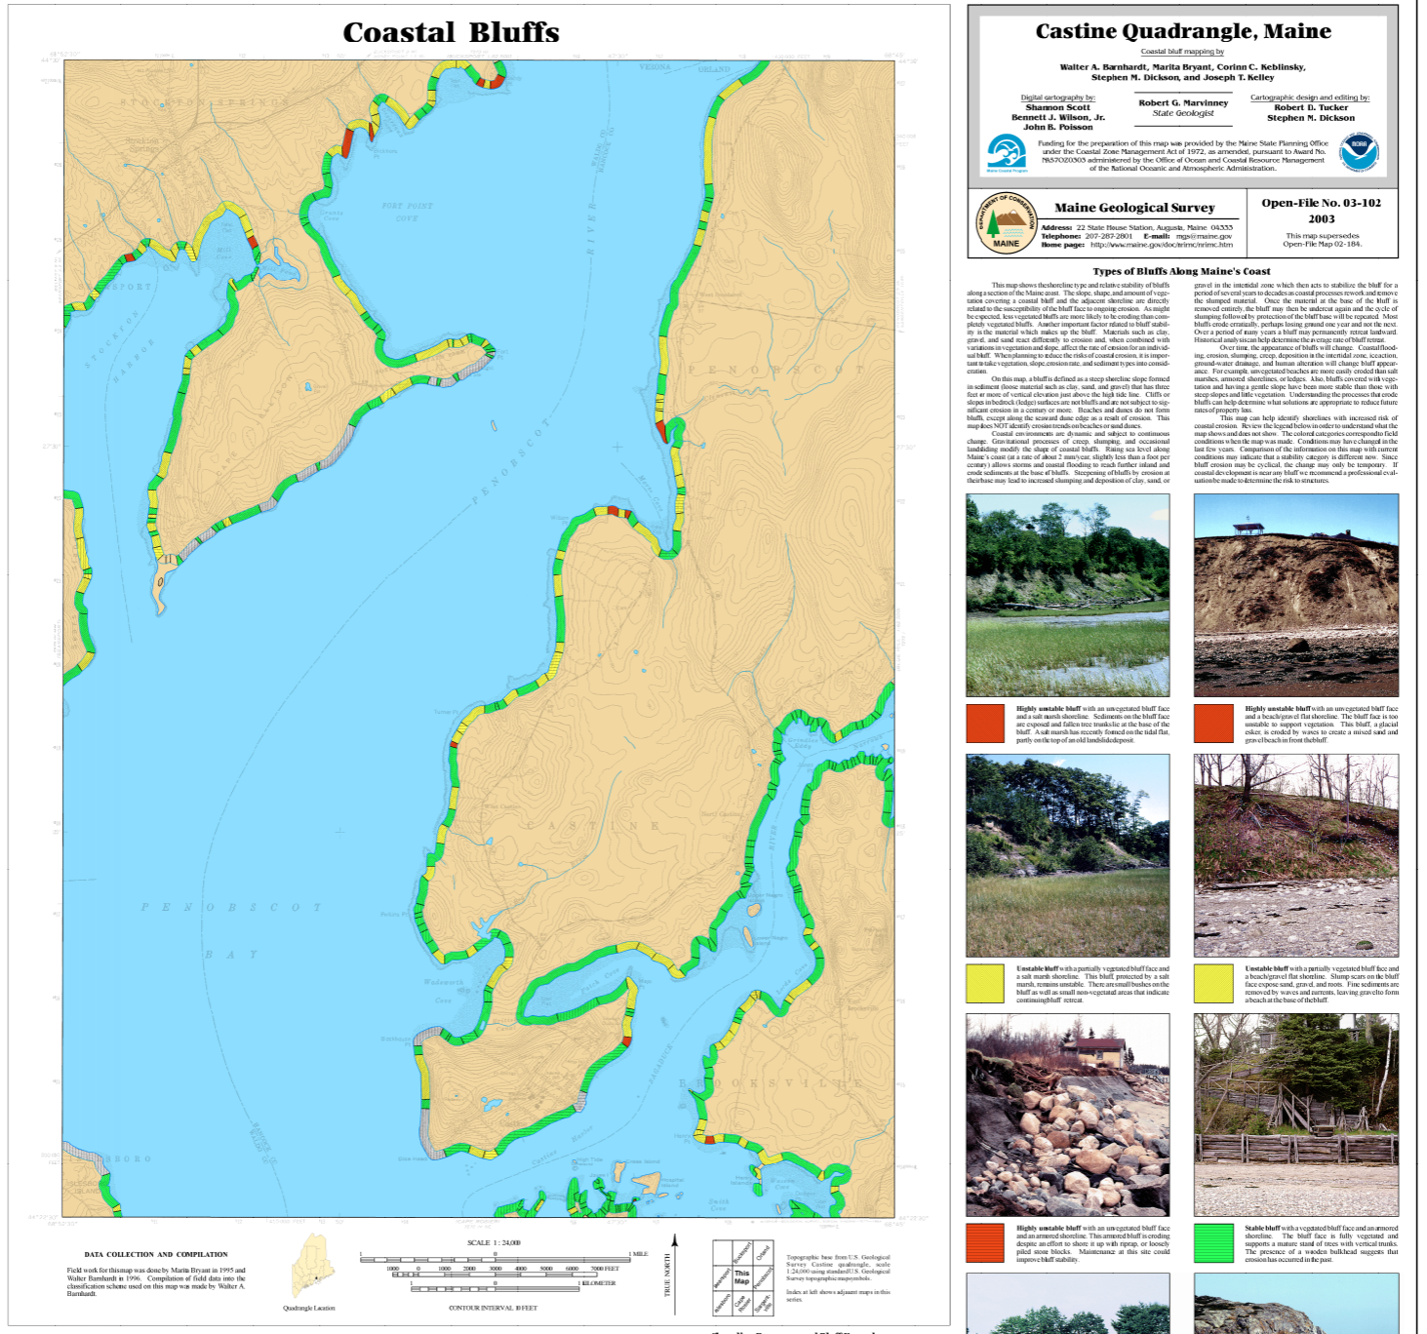
TAKING EXAMPLES FROM OTHER STATES
Simplifying a complex analysis into high/med/low designations can make information more easily ingested by the public.
STATE OF ALASKA
DIVISION OF GEOLOGICAL & GEOPHYSICAL SURVEYS

Slide 25
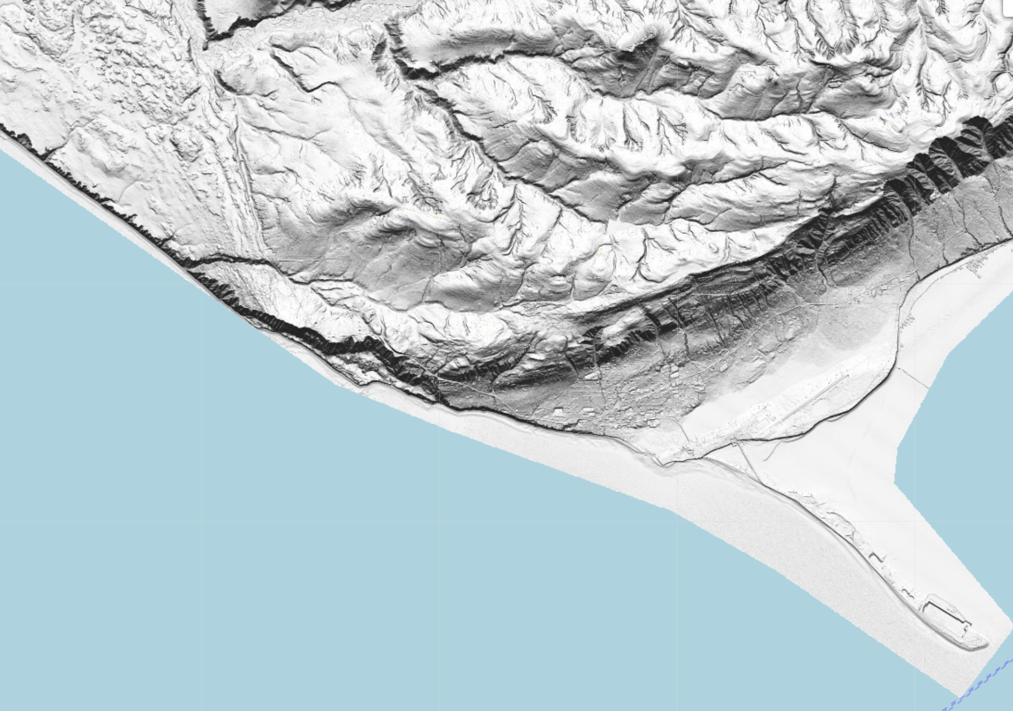
PROJECT SCOPE
Lidar and oblique imagery—DGGS was able to collect lidar and oblique imagery in 2019 as a part of the landslide project.
Establish NOAA Authoritative Tidal Datum—NOAA’s Office for Coastal Management funded the collection of an authoritative datum in 2018, which will be available for this work.
Historical Shoreline Assessment—City of Homer completed up to 2012 shoreline.
Review existing policies for other coastal states.
Update shoreline change assessment with 2019 lidar-derived shoreline.
Sample lidar for alongshore coastal segments and delineate visual bluff stability features; compute coastal bluff stability metrics.
Compute correlations between bluff stability features and metrics.
Project Coordination! Kick-off meeting, project progress, and final meeting (open to public optional).
Project Activities
2019 | 2020 |  |  | 2021
Sept-Dec | Jan-April | May-Aug | Sept-Dec | Jan-April | May-Aug
Accounts | Kick-off meeting | DGGS staff in the field | Progress Meeting |  | Final Meeting
Hiring | Analysis |  | Analysis |  | Deliver final products to FEMA and commission
STATE OF ALASKA
DIVISION OF GEOLOGICAL & GEOPHYSICAL SURVEYS

Slide 26
PROJECT DELIVERABLES
Summarized recommendations for City code updates with a suite of options based on mapped features.
Coastal Bluff Stability Database—alongshore gridded features, which will include all measurements considered in analysis (e.g. position of MHW shoreline, beach slope, bluff toe height, bluff slope, etc.)
Coastal Bluff Stability Map and Report—map will show the linear feature of the coastal bluff stability database with features that show the stability of the bluff, while the report will be a user-guide to the map.
STATE OF ALASKA
DIVISION OF GEOLOGICAL & GEOPHYSICAL SURVEYS

Slide 27
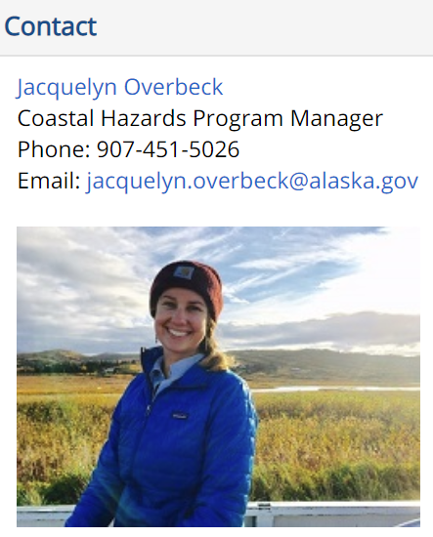
CONTACT INFORMATION
Are there any preferences to paths for research coastal zoning methods?
Are there any products that weren’t discussed that need to be included?
What is the capacity for the City of Homer to use GIS data?
How does this project fit in with existing geospatial datasets?
Next meeting might not be until next year. When would the public get involved?
Who is the best contact for small questions to determine if they should be brought to the Planning Commission?
STATE OF ALASKA
DIVISION OF GEOLOGICAL & GEOPHYSICAL SURVEYS

