Slide 1
Homer Green stormwater management system
City of Homer Public Works Department

Slide 2
Water, Water Everywhere
History of drainage research
What’s missing?
Drainage problems
Concepts for Green Infrastructure Projects
Next Steps

Slide 3
Early research
1979 Drainage Management Plan (DMP)
1981- 82 Revised Drainage Management Plan
Focused on traditional drainage management – stormwater, culverts & ditches
Did not address groundwater, bluff erosion, water quality, etc.

Slide 4
“Modern” Research
2003 – Wetland Functional Assessment Guidebook; ADEC
2004 – Soil Survey of Western Kenai Peninsula; USDA, NRCS and others
2007 – Homer Stormwater and Meltwater Management and Mitigation Handbook; Allegra Bukojemsky & David Scheer
2004-2009 Privately-funded work – Coble Geophysical Services, Mike McCarthy

Slide 5
More research “recent” times
2014 Beluga Area Planning Reference – Homer Soil & Water Cons. District
2020 Low Impact Dev. Planning – Kinney Engineering for City of Homer
2020 - Coastal Bluff Stability; AK Div. of Geological/Geophysical Surveys

Slide 6
What’s been missing?
Connection between the research findings
Implementation of the recommendations
Consistent link with land development regulations
Focus on water quality

Slide 7
We still have drainage problems
Drainage is damaging private property.
Near-surface ground water is triggering bluff erosion.
Drainage is threatening slope stability.
Silt-laden storm water is flowing carried into streams.

Slide 8
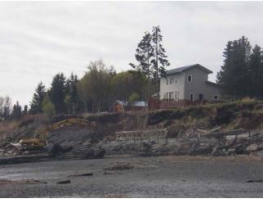
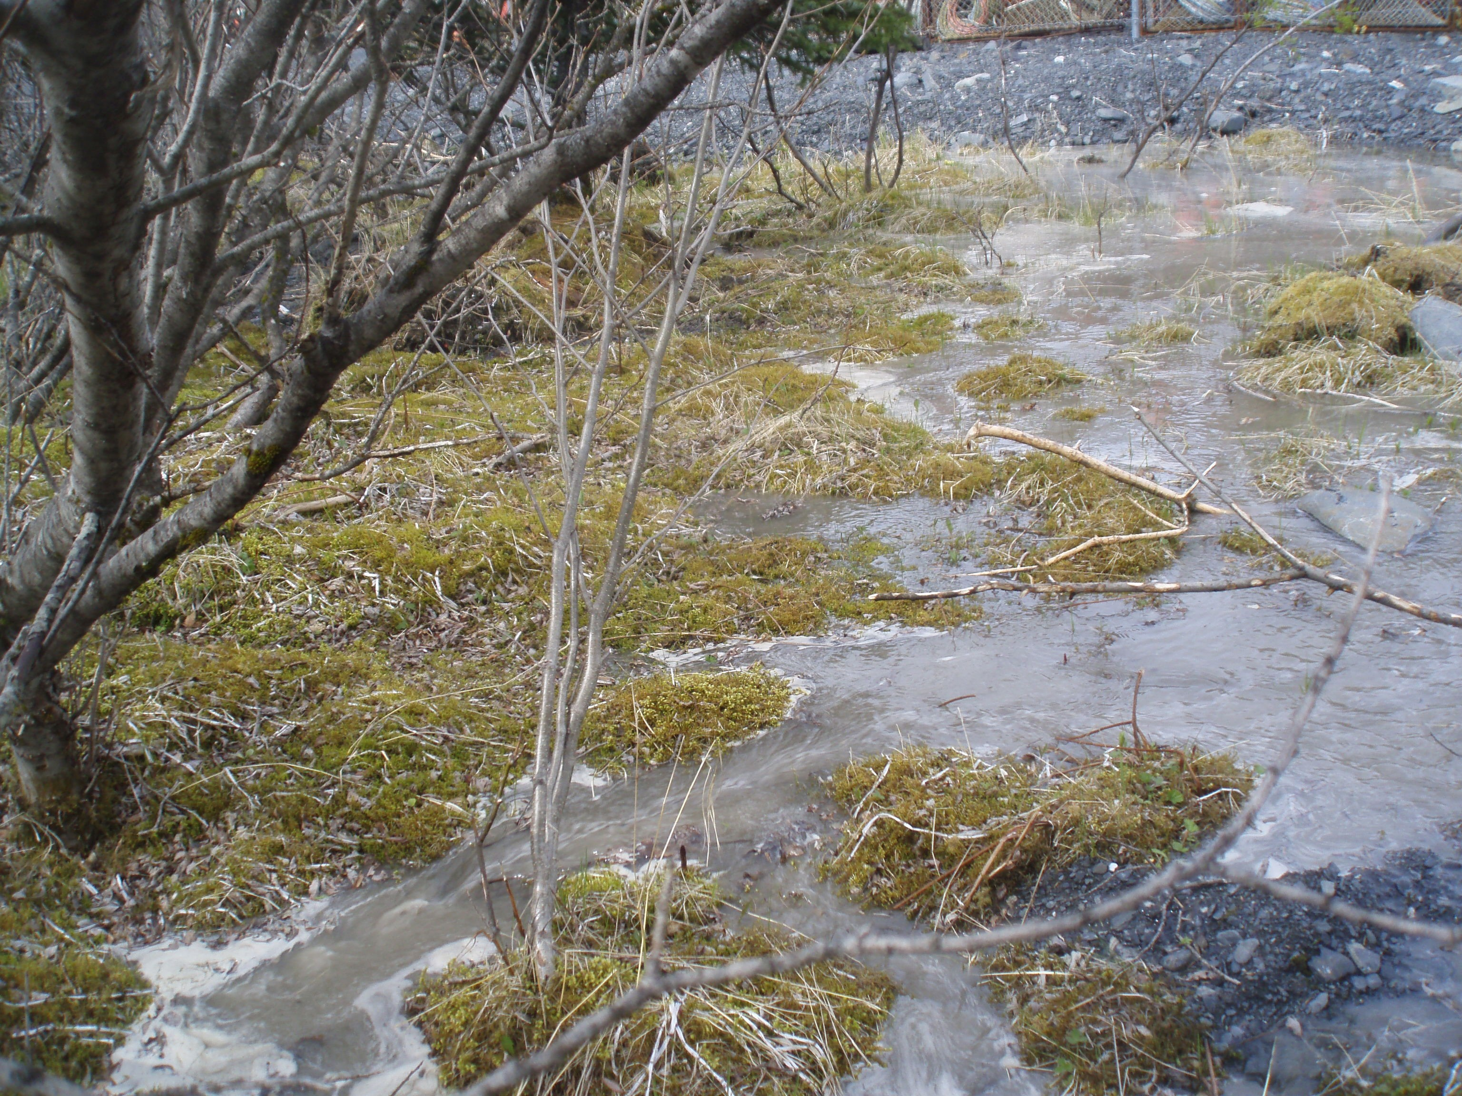
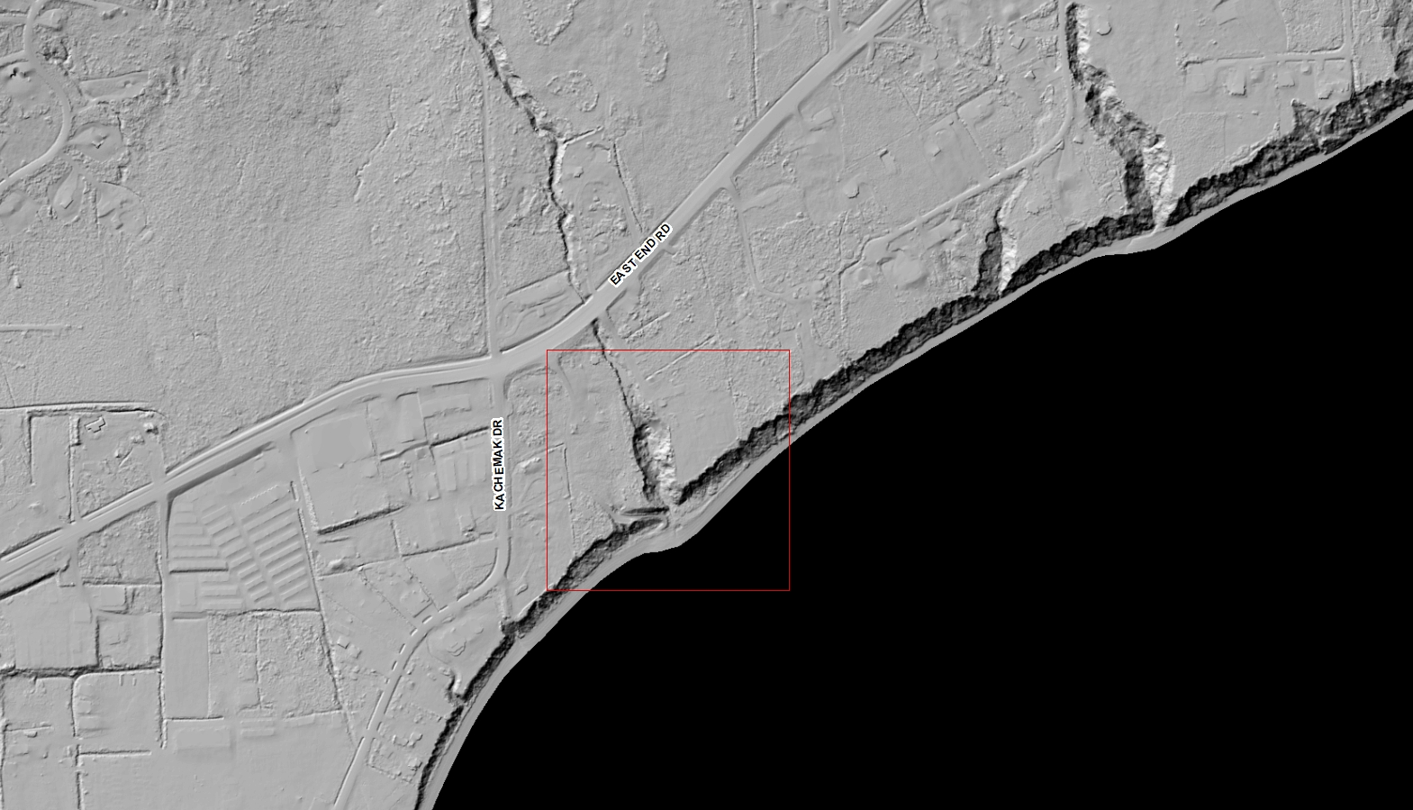
Flooding & Erosion
Photograph taken by Geoff Coble
USACE
Photograph taken by Chad W. Smith, U.S. Geological Survey
Public Domain

Slide 9
Short term solutions cause long term problems.
Private developments don’t always look downstream.
Inspection efforts don’t address all development activity.
Road/drainage maintenance focuses on efficiency, not sustainability.
Water quality not always a priority.
Windows of opportunity to use natural systems are closing.

Slide 10
Baycrest Subdivision
Kachemak Drive
Kachemak drive
Eroded bluff materials deposited on beach
Sediment laden storm water that outfalls directly to Kachemak Bay
Homeowner revetment solution along beach

Slide 11
What’s the answer?
Acknowledge that nature always wins.
Work with nature, not against it.
Plan for the long term.

Slide 12
Green Stormwater management system
Includes four Green Infrastructure sub-systems
Uses natural resources to diffuse water quantity and protect water quality
Manages water flow to mitigate bluff erosion

Slide 13
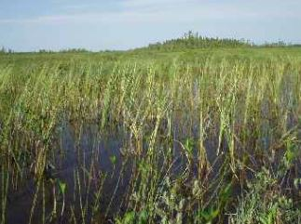
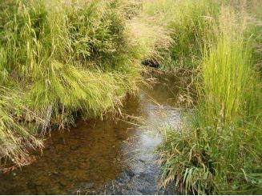
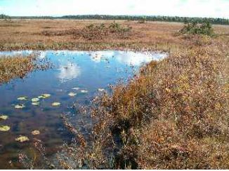
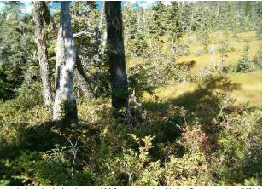
wetlands
Peatland Pool
Riparian
Relict Glacial Lakebed
Headwater Fen

Slide 14
Green Infrastructure Element #1 – Bishop’s Beach Stormwater Treatment System
Uses existing wetlands to store and treat storm water from Main Street and Old Town storm drains
Diffuses water volumes flowing into Beluga Slough and Kachemak Bay
Protects water quality of Beluga Slough and Kachemak Bay
Ties into Bishop’s Beach Park

Slide 16
Green Infrastructure Element #2 – BeN Walters Stormwater Treatment System
Uses existing wetlands to store and treat storm water from Ben Walter’s Way and upstream watershed
Diffuses water volumes flowing into Beluga Lake
Protects water quality of Beluga Lake, Beluga Slough and Kachemak Bay
Ties into Ben Walters Park

Slide 18
Green infrastructure element #3 – baycrest area Storm Drain
Carries drainage from Baycrest Hill area to Bidarki Creek
Reduces potential for bluff erosion and slope instability
Protects water quality of Kachemak Bay
Provides opportunity for mini-hydro facility

Slide 20
Green infrastructure element #4 – Checkerboard Sponge
Uses 50+ acres of existing wetlands to store and treat drainage from industrial/commercial land and upstream watersheds, including those in Kachemak City
Reduces potential for bluff erosion on Kachemak Drive East
Protects water quality of Kachemak Bay
Provides opportunity for mini-hydro facility

Slide 22
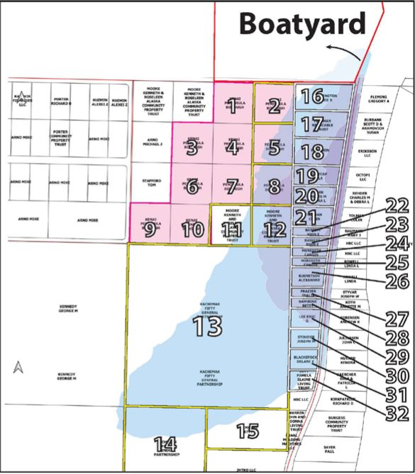
Storm water retention area
Cool colors indicate low-lying wetlands that act as a retention area for large volumes of storm water
Credit: Coble Geophysical

Slide 23
Next steps
Refine the concepts
Secure the funding
Acquire the real estate
Design/build the projects
Review/adjust regulations

